Slide 1
Cutaneous Manifestations of Systemic Disease
Holly Edmonds, MD
Chief Resident
Department of Dermatology

Slide 2
Brief Review of terminology…

Slide 3
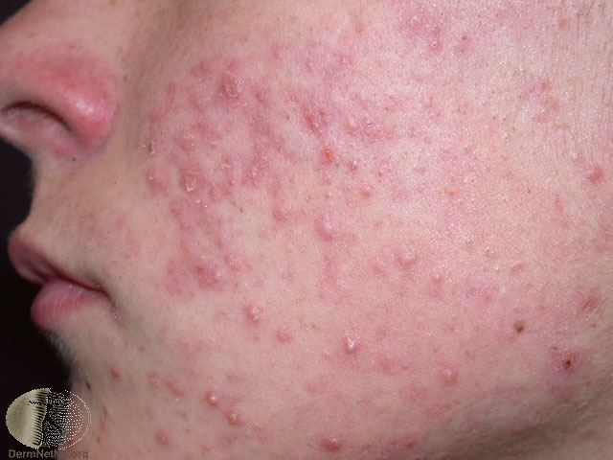
Zits???

Slide 4
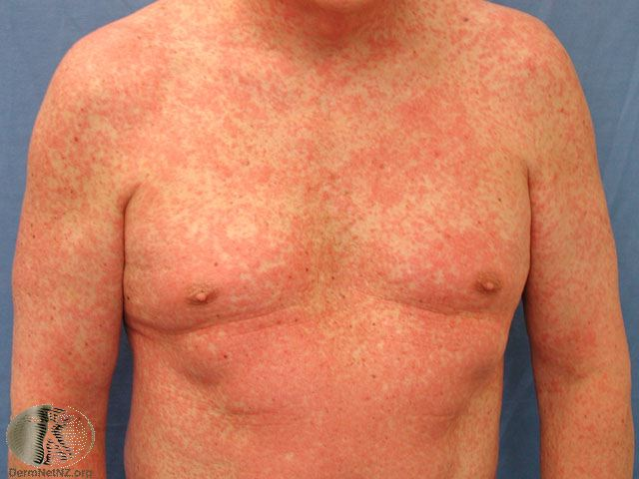
Red Rash???

Slide 5
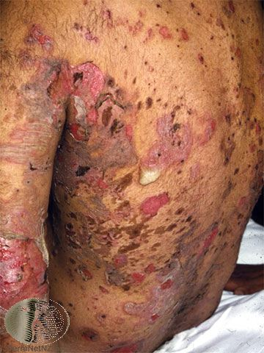
“Nasty… just call the derm service and get a consult!”

Slide 6
You have to learn the language!

Slide 7
Description of a skin lesion:
Type
Shape
Arrangment
Distribution
OH!!! DATS what that rash is!!!

Slide 8
TYPE
Primary lesion
Secondary lesion
Color
Palpation

Slide 9
MACULE/PATCH

Slide 10
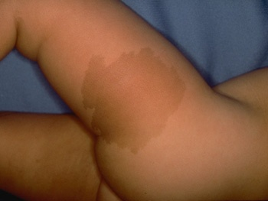

Slide 11
PLAQUE

Slide 12
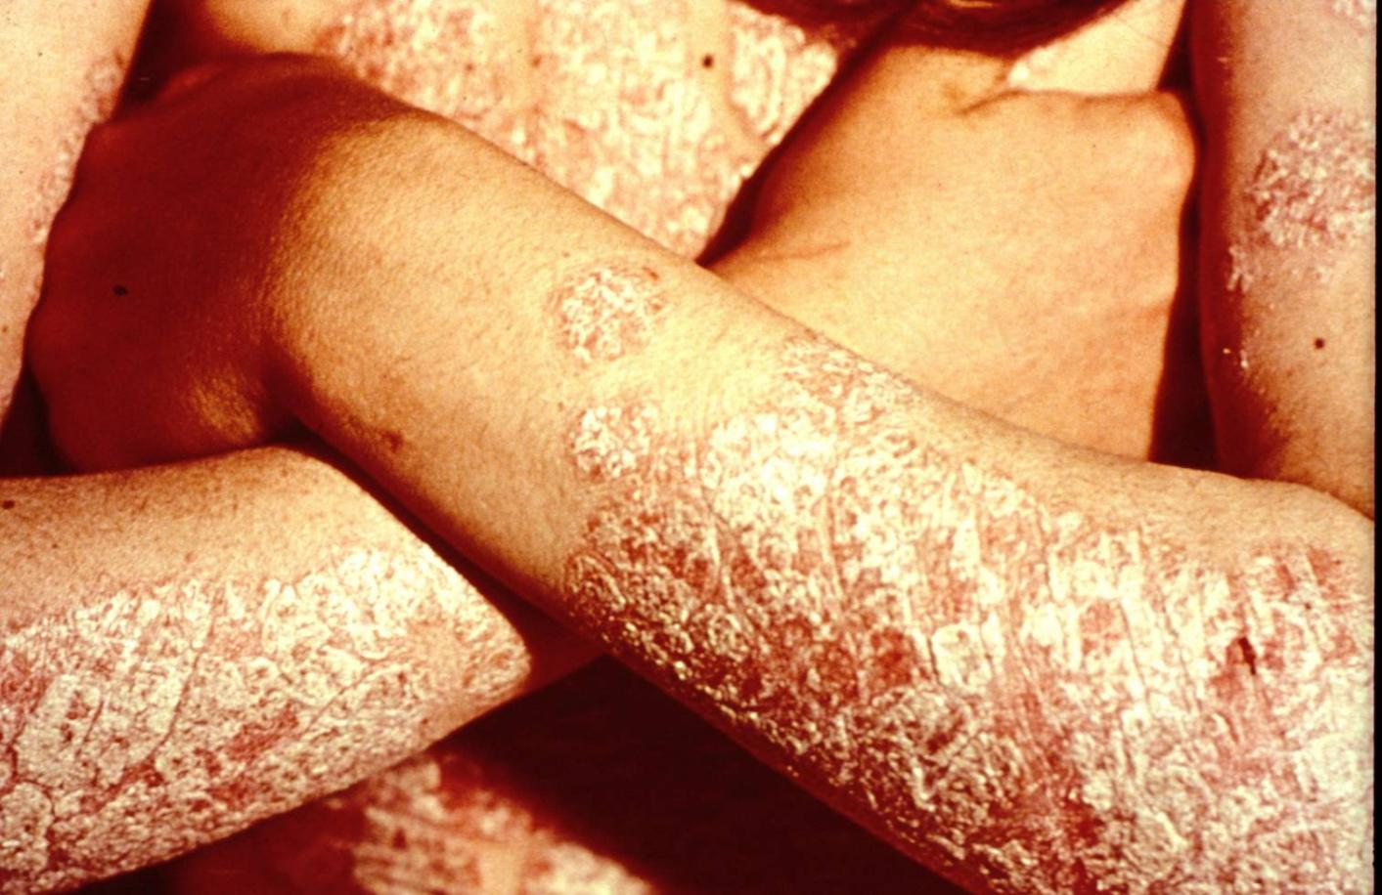

Slide 13
PAPULE

Slide 14
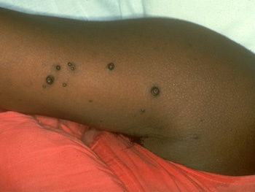

Slide 15
NODULE

Slide 16
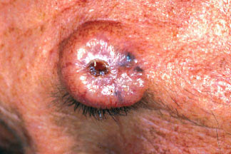

Slide 17
VESICLE/BULLA

Slide 18
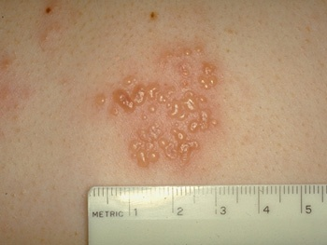

Slide 19
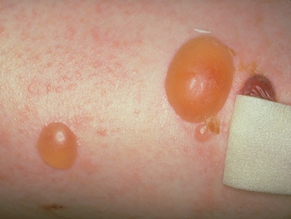

Slide 20
PUSTULE

Slide 21
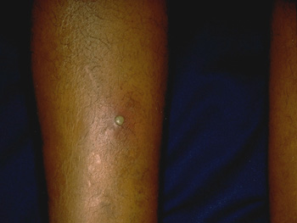

Slide 22
WHEAL

Slide 23
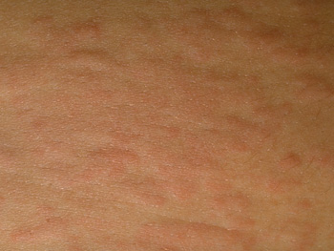

Slide 24
SCALE

Slide 25
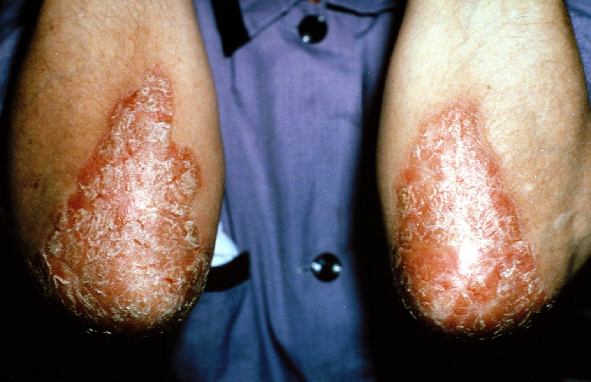

Slide 26
CRUST

Slide 27
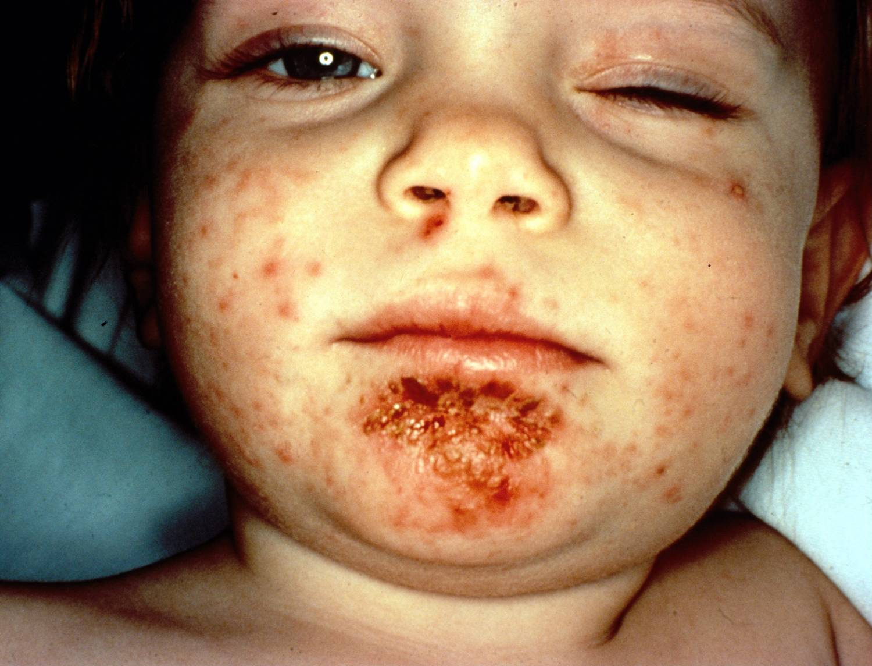

Slide 28
LICHENIFICATION

Slide 29
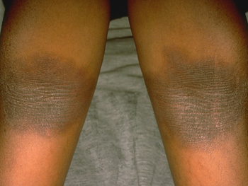

Slide 30
EROSION

Slide 31
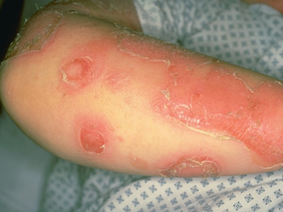

Slide 32
ULCER

Slide 33
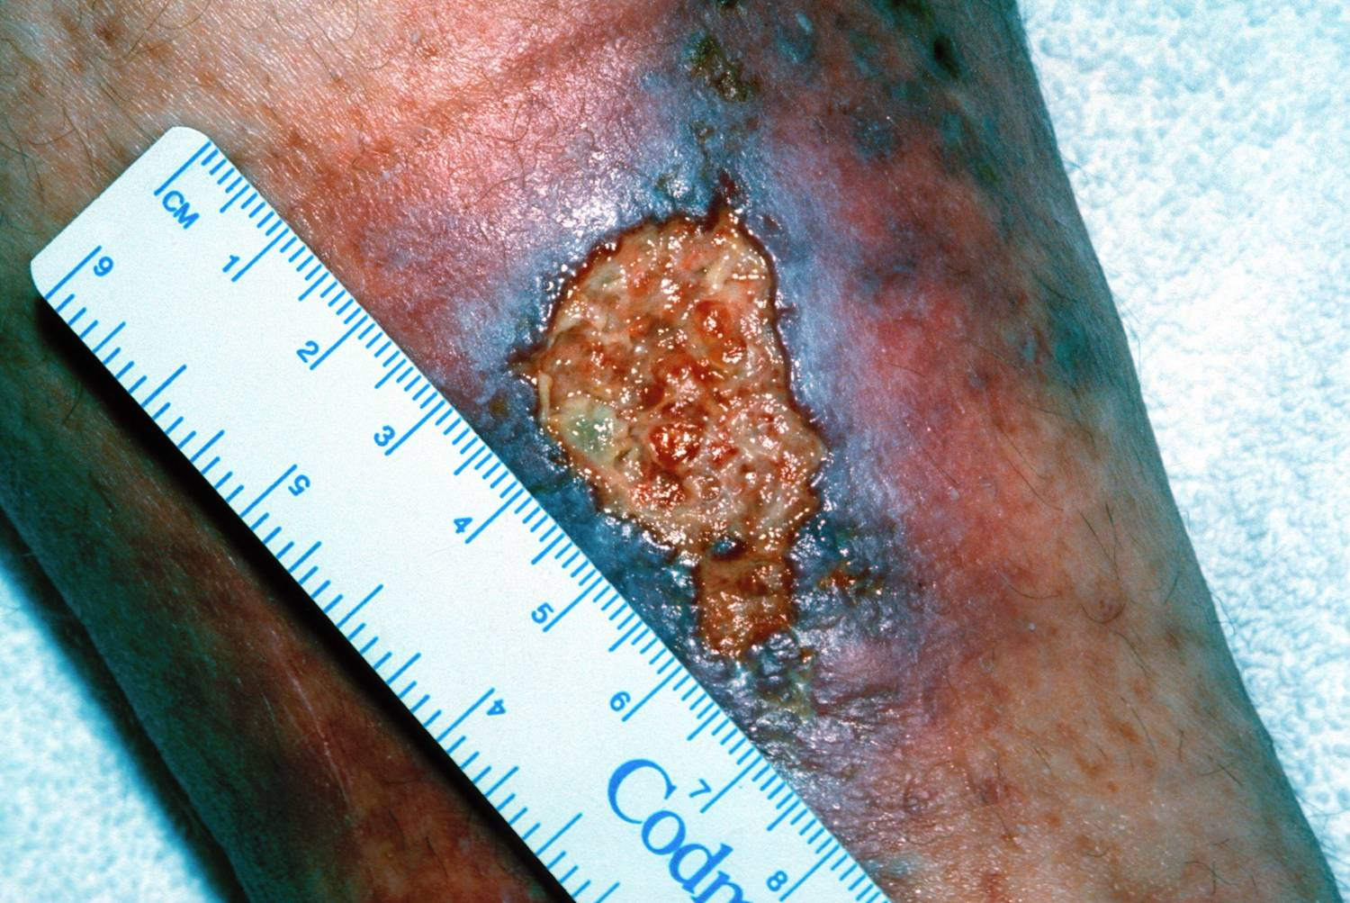

Slide 34
ATROPHY

Slide 36
EXCORIATION

Slide 37
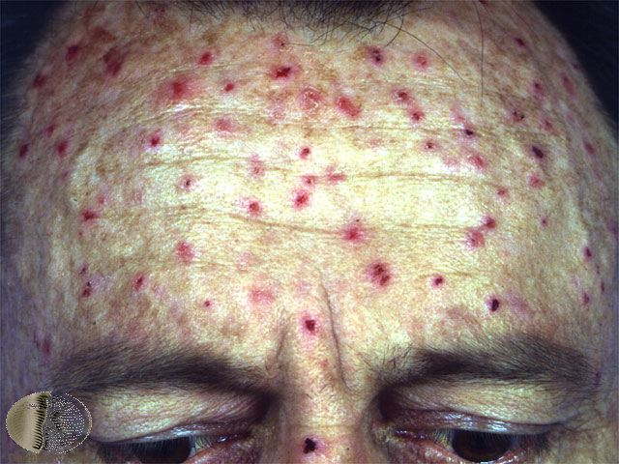

Slide 38
FISSURE

Slide 39
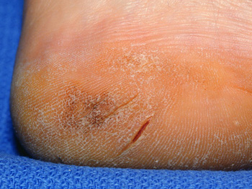

Slide 40
SCAR

Slide 41
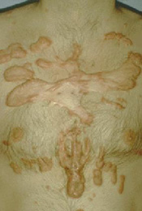

Slide 42
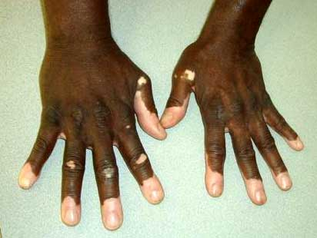
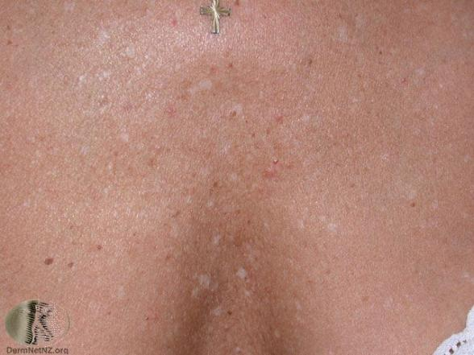
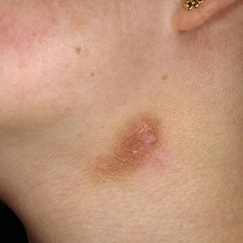
Color

Slide 43
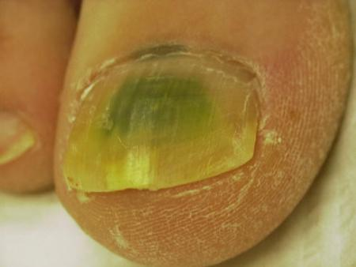
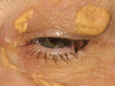
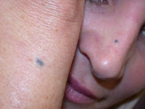
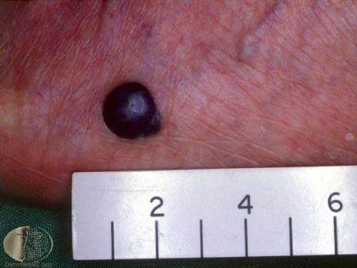
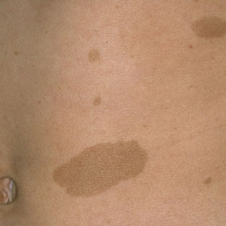
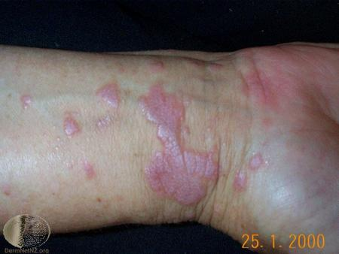
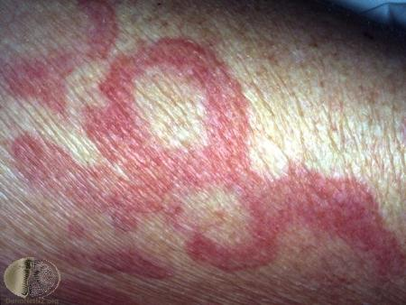
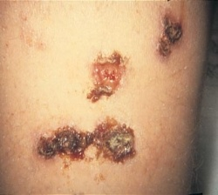
Color

Slide 44
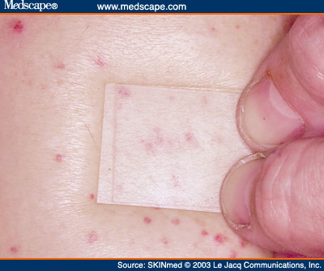
Color

Slide 45
Palpation
Consistency
Firm, Soft, Fluctuant, Boardlike
Temperature deviation (hot or cold)
Mobility
Presence of tenderness

Slide 46
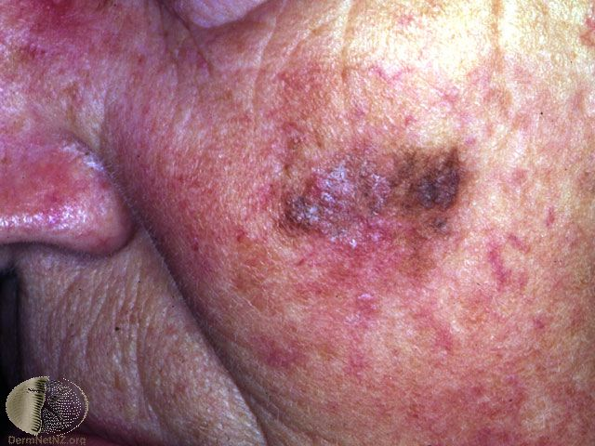
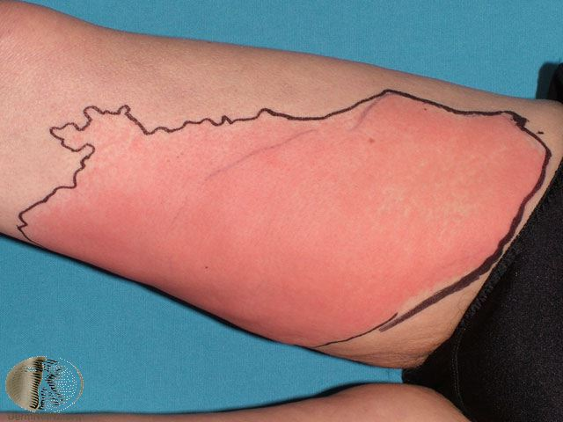
Margination
Ill-defined
vs.
Well-defined

Slide 47
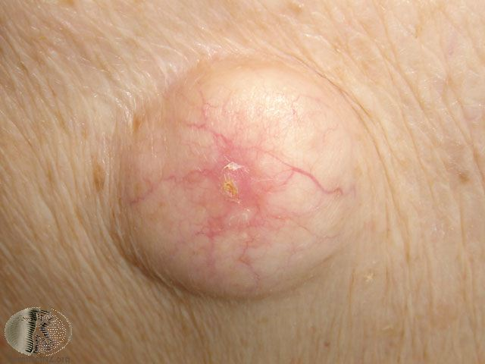
SHAPE

Slide 48
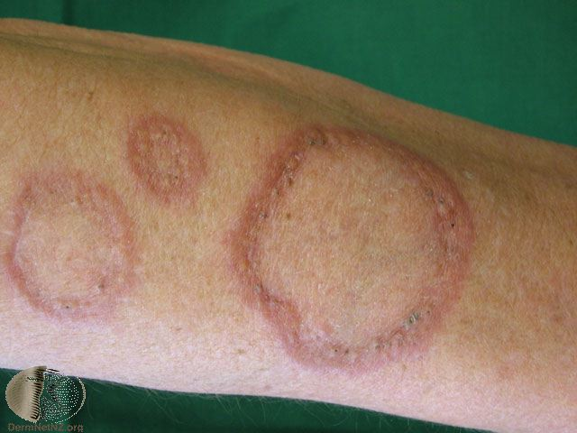
SHAPE

Slide 49
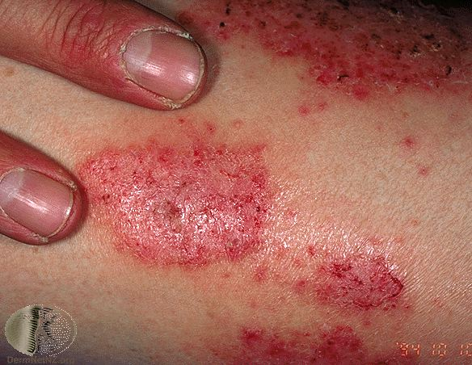
SHAPE

Slide 50
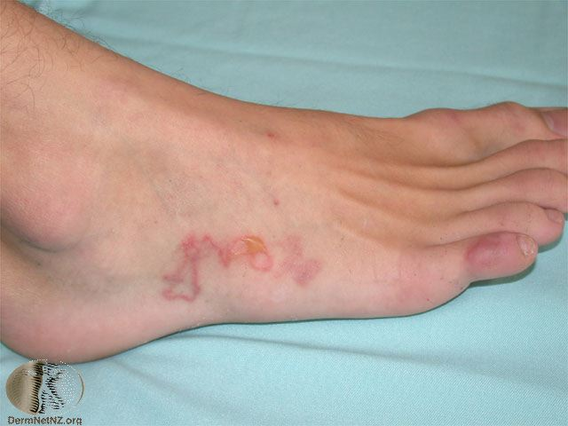
SHAPE

Slide 51
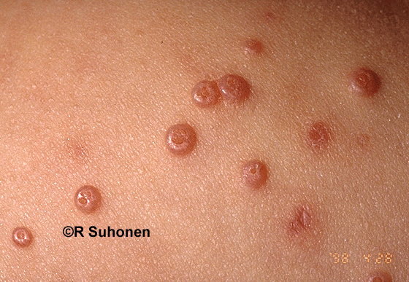
SHAPE

Slide 52
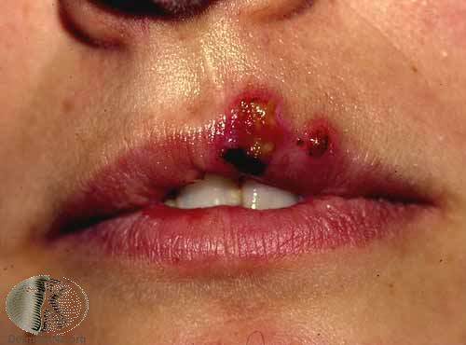
ARRANGEMENT

Slide 53
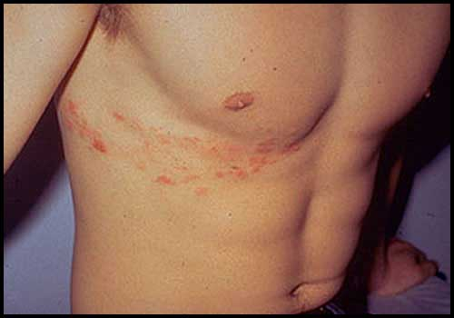
ARRANGEMENT

Slide 54
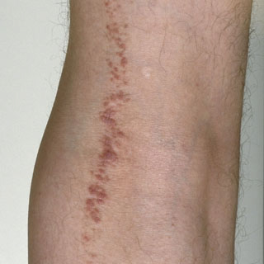
ARRANGEMENT

Slide 55
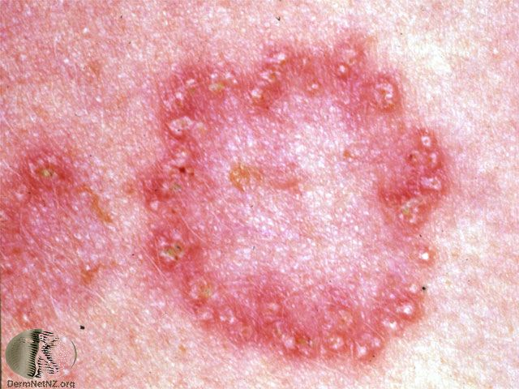
ARRANGEMENT

Slide 56
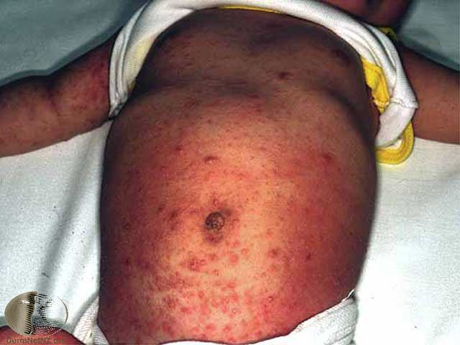
ARRANGEMENT

Slide 57
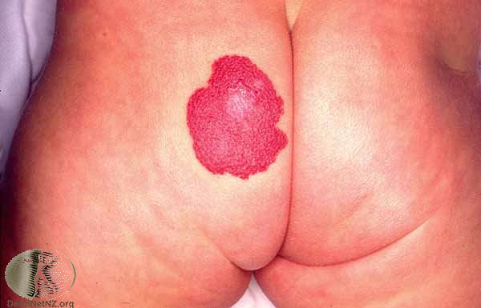
DISTRIBUTION

Slide 58
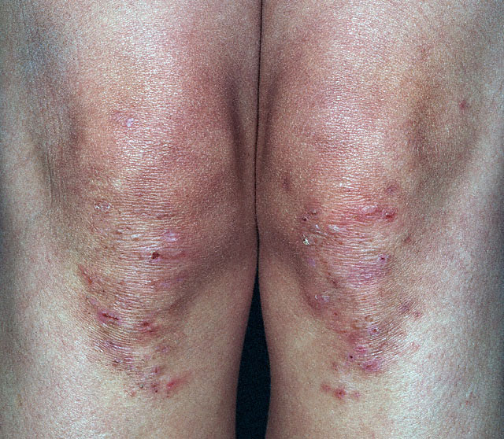
DISTRIBUTION

Slide 59
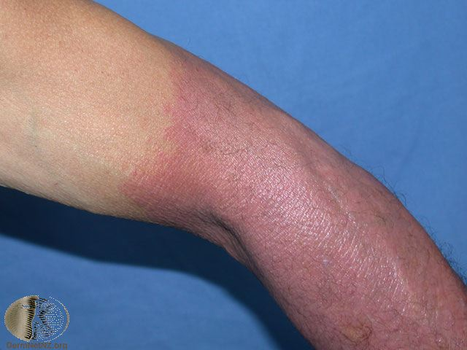
DISTRIBUTION

Slide 60
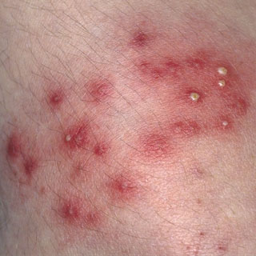
DISTRIBUTION

Slide 61
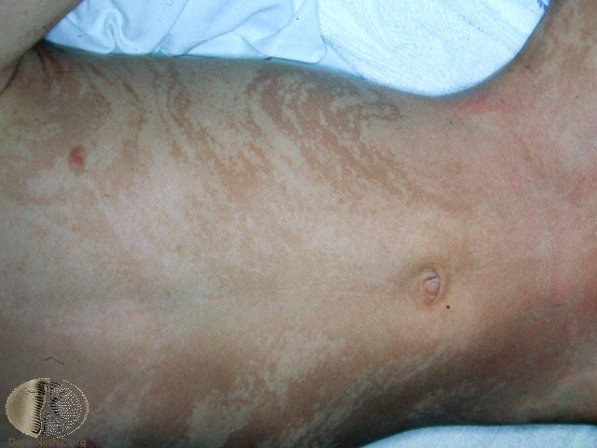
DISTRIBUTION

Slide 62
Cutaneous Manifestations
Diabetes Mellitus
Renal Disease
Gastrointestinal disorders
Rheumatologic disease
Hepatitis C
Thyroid disease
Paraneoplastic disease
Nutritional disease

Slide 63
Diabetes Mellitus
Acanthosis Nigricans
Diabetic Dermopathy
Bullosis Diabeticorum
Necrobiosis Lipoidica
Diabetic Foot Ulcers

Slide 64
Acanthosis Nigricans
African Americans and Hispanics > Caucasians
Associated with obesity, insulin resistance
Hyperpigmented velvety plaques of the flexures
Genetic sensitivity of the skin to hyperinsulinemia
Malignant form a/w gastric ACA

Slide 65
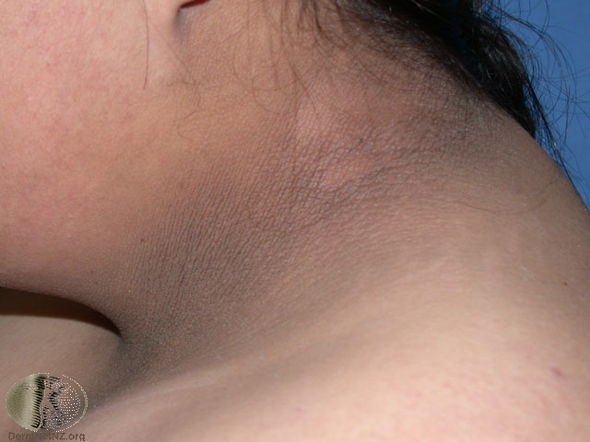
Acanthosis Nigricans
Notes:
African Americans and Hispanics > Caucasians
Associated with obesity, insulin resistance
Hyperpigmented velvety plaques of the flexures
Genetic sensitivity of the skin to hyperinsulinemia
Malignant form a/w gastric ACA

Slide 66
Acanthosis Nigricans

Slide 67
Diabetic Dermopathy
AKA “shin spots” or pigmented pretibial papules
Most common cutaneous manifestation of diabetes
Benign asymptomatic red brown macules on shins
No treatment needed

Slide 68
Diabetic Dermopathy
Notes:
AKA “shin spots” or pigmented pretibial papules
Most common cutaneous manifestation of diabetes
Benign asymptomatic red brown macules on shins
No treatment needed

Slide 69
Bullosis Diabeticorum
Rapid onset painless, tense blisters on hands and feet
Trauma and microvascular disease may play a role
Spontaneous healing in 2-5 weeks

Slide 70
Bullosis Diabeticorum
Notes:
Rapid onset painless, tense blisters on hands and feet
Trauma and microvascular disease may play a role
Spontaneous healing in 2-5 weeks

Slide 71
Necrobiosis Lipoidica
20-35% of patients with NLD have diabetes, only about 1-3% of diabetics have NLD
Start as red-brown papules and progress to well defined yellow-brown atrophic plaques with irregular violaceous borders and telangiectasias. Shins #1 site.
Ulceration in 35%.
Glucose control will not clear NLD

Slide 72
Necrobiosis Lipoidica Diabeticorum
Notes:
20% of patients with NLD have diabetes, only about 1-3% of diabetics have NLD
Start as red-brown papules and progress to well defined yellow-brown atrophic plaques with irregular violaceous borders and telangiectasias. Ulceration in 35%. Shins most common.
Glucose control will not clear NLD

Slide 73
Diabetic Eruptive Xanthomas
Seen in uncontrolled diabetes, hypertriglyceridemia
Sudden crops on firm, non-tender yellow papules with a red rim on extensors
Control glucose and lipid reduction will reduce lesions

Slide 74
Diabetic Eruptive Xanthomas
Notes:
Seen in uncontrolled diabetes, hypertriglyceridemia
Sudden crops on firm, non-tender yellow papules with a red rim on extensors
Control glucose and lipid reduction will reduce lesions

Slide 75
Diabetic Neurotropic Ulcers
Peripheral neuropathy leads to unnoticed trauma
Vascular complications may lead to ulcers and complicate ulcer healing
Risk of amputation goes up 8x once these develop

Slide 76
Diabetic Neurotropic Ulcers
Notes:
Peripheral neuropathy leads to unnoticed trauma
Vascular complications may lead to ulcers and complicate ulcer healing
Risk of amputation goes up 8x once these develop

Slide 77
Renal disease
Pruritis
Perforating dermatosis
Calciphylaxis
Nephrogenic Fibrosing Dermopathy

Slide 78
Pruritis
Most common cutaneous manifestation of renal disease
Seen in both peritoneal and hemodialysis patients
Unknown mechanism, unsatisfactory therapy- UVB helps the most

Slide 79
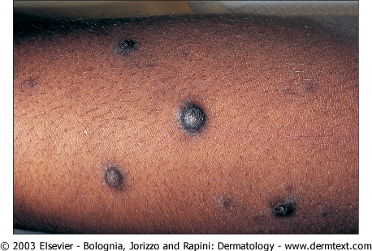
Pruritis
Notes:
Most common cutaneous manifestation of renal disease
Seen in both peritoneal and hemodialysis patients
Unknown mechanism, unsatisfactory therapy- UVB helps the most

Slide 80
Perforating Disorder
Acquired Perforating Dermatosis of ESRD
Umbilicated papules/nodules with central hyperkeratotic core
Notes:
Transepidermal elimination of altered dermal substances
Unknown etiology, may be related to dermal accumulation of microdeposits of calcium
Treatments- steroids, retinoids, cryotherapy, UVB

Slide 81
Perforating dermatosis

Slide 82
Perforating dermatosis

Slide 83
Calciphylaxis
Painful purpuric plaques and retiform purpura
More proximal lesions = poorer prognosis
Notes:
Deposits of calcium in tissue decondary to abnormal calcium and phosphate metabolism
Histologically, medial and intimal calcification of small arteries
Treatment includes parathyroidectomy, wound care, sodium thiosulfate

Slide 84
Calciphylaxis

Slide 85
Nephrogenic Fibrosing Dermopathy
Woody, indurated plaques with peau d’orange appearance
Usually spares the face, palms, soles
Associated with gadolinium contrast for MRIs
Notes:
Newly recognized fibrosing disorder in the setting of renal failure
No specific lab abnormalities
Histologically- fibrobalsts prolitferate with slight increase in dermal mucin

Slide 86
Nephrogenic Fibrosing Dermopathy

Slide 87
Gastrointestinal disorders
Henoch Schonlein Purpura
Dermatitis Herpetiformis
Inflammatory Bowel Disease

Slide 88
Henoch Schonlein Purpura
Palpable purpura, urticaria, necrotic ulcers on buttocks, distal legs
Symmetric
IgA vasculitis
GI symptoms + arthritis, long term concern for hypertension and renal involvement
Usually under 20, following an URI
Notes:
Usually under 20 yo, most with preceeding URI
Histologically leukocytoclastic vasculitis with IgA deposits
GI: bleeding, pain, cramping, intussuception; myalgias, fever, HA, hematuria, arthritis, arthralgias

Slide 89
HSP

Slide 90
HSP

Slide 91
Dermatitis Herpetiformis
Symmetric, grouped vesicles on extensors
Very pruritic!
All patients have gluten-sensitive enteropathy, only 20% symptomatic
Associated with HLA-DQ2, Hashiomoto’s thyroiditis, lymphoma, IDDM
Cutaneous findings are due to autoantibodies to epidermal transglutaminase
Treatment- rapidly responsive to dapsone
Notes:
Associated with HLA-DQ2, Hashiomoto’s thyroiditis, lymphoma, IDDM
Cutaneous findings are due to autoantibodies to epidermal transglutaminase
GI symptoms: diarrhea, bloating, steatorrhea- a/w ab to gliadin, tranglutaminase
Treatment- rapidly responsive to dapsone

Slide 92
Dermatitis Herpetiformis

Slide 93
Inflammatory Bowel Disease
Crohn’s and Ulcerative Colitis
Notes:
Have similar manifestations

Slide 94
Oral Crohn’s
Linear ulcerations, cobblestoned oral mucosa
UC may have aphthous ulcers that develop as IBD flares
Notes:
Linear ulcerations, cobblestoned oral mucosa
UC may have aphthous ulcers that develop as IBD flares

Slide 95
Metastatic Crohn’s
See fissures and fistulas with Crohn’s
Metastatic Crohn’s are nodules, plaques and ulcerations usually in intertriginous areas which can mimic erythema nodosum
Notes:
Get fissures and fistulas with Crohn’s
Metastatic Crohn’s are nodules, plaques and ulcerations usually in intertriginous areas which can mimic erythema nodosum

Slide 96
Erythema Nodosum
Tender red nodules on anterior lower legs, precedes or occurs with IBD flares, UC more common
Most EN is idiopathic, also can be related to oral contraceptives or abx, preceding strep or mycobacterial infxn
Notes:
Tender red nodules on anterior lower legs, precedes or occurs with IBD flares, UC more common
Most EN is idiopathic, also can be related to oral contraceptives or abx, preceding strep or mycobacterial infxn

Slide 97
Pyoderma Gangrenosum
More common in UC
Papules, pustules, hemorrhagic blisters enlarge and ulcerate with dusky undermined edges
Frequently on legs or around stoma sites
Treat with steroids, often gets better as IBD gets better
Notes:
More common in UC
Papules, pustules, hemorrhagic blisters enlarge and ulcerate with dusky undermined edges
Frequently on legs or around stoma sites
Treat with steroids, often gets better as IBD gets better

Slide 98
Rheumatologic Disorders
Lupus Erythematosis
Dermatomyositis
Reiter’s Disease

Slide 99
Lupus Erythematosis
Classification:
Systemic Cutaneous Lupus (SLE)
Subacute Cutaneous Lupus (SCLE)
Discoid Lupus (DLE)
Neonatal Lupus

Slide 100
SLE
+ANA
+Sm and dsDNA
Butterfly Rash
Poikiloderma
Photodistrubited erythematous, papular scaling eruption sparing knuckles.
Notes:
Poikiloderma = hyperpigmentation, hypopigmentation, telangiectasias, atrophy in sun exposed areas

Slide 101
SLE

Slide 102
SLE

Slide 103
SLE

Slide 104
Dermatomyositis
Poikiloderma favoring scalp, periocular (Heliotrope rash), and extensor skin sites
Nailfold telangiectasias
Gottron’s papules
Notes:
Connective tissue-vascular disorder of uncertain etiology
Bimodal age distribution with both juvenile and adult forms.
Proximal extensor inflammatory myopathy.
Elevated CPK
Therapy includes systemic corticosteroids and possibly immunosuppressive drugs with the prognosis being very good except for adults with associated advanced malignancy.

Slide 105
Dermatomyositis

Slide 106
Dermatomyositis (periungal telangiectasias, gottrons papules)

Slide 107
Reiter’s Disease
Urethritis, arthritis, ocular findings, and oral ulcers in addition to psoriasiform skin lesions.
Keratoderma blenorrhagicum (feet)
Balanitis circinata (penis)
Notes:
Can’t see, can’t pee, can’t climb a tree
The skin lesions occur in approximately 5% of the patients, with a predilection for the soles, extensor surfaces of the legs, penis, dorsal aspects of the hands, fingers, nails and scalp. The lesions on the plantar surface usually have thick yellow scale and are often pustular (keratoderma blenorrhagicum). Psoriatic plaques on the penis are referred to as balanitis circinatum.
Reiter's disease shows a strong association with HLA-B27. The disease often follows a Chlamydia or gastrointestinal infection

Slide 108
Reiter’s Disease Keratoderma Blenorrhagicum

Slide 109
Reiter’s Disease (balanitis circinata)

Slide 110
Hepatitis C virus
Porphyria Cutanea Tarda
Lichen Planus
Pruritis
Notes:
ssRNA virus
3.9 million infected in US
IV drug abuse, nosocomial inefction, transfusion, RARE sexual/vertical transmission
70% of infected progress to chronic HCV and up to 11% of these will develop hepatocellular cancer
Noncutaneous manifestations: Autoimmune thyroiditis, pulmonary fibrosis

Slide 111
Porphyria Cutanea Tarda
Vesicles and bullae on sun-exposed areas, scarring with milia
Hypertrichosis
Fragile skin with sclerodermoid changes
Notes:
Deficiency in Uroporphyrinogen decarboxylase; inherited, sporadic or a/w HCV
In one study 82% of patients with PCT had HCV
Triggers: alcohol, estrogens, and polygenated hydrocarbons
Treatment- phlebotomy, IFN, antimalarials

Slide 112
PCT

Slide 113
PCT (hypertrichosis)

Slide 114
Lichen Planus
Purple, pruritic, polygonal papules
Koebner phenomenon
Wickham’s striae
50% with mucosal involvement
Notes:
HCV association 1-35%
Erosive mucosal LP has highest correlation with HCV

Slide 115
Lichen Planus

Slide 116
Mucosal Lichen Planus

Slide 117
Pruritis
Excoriations, lichenification, and prurigo nodularis
Notes:
Very common in chronic HCV
Generalized pruritis, scratching usually doesn’t help
Not always correlated with level of bile salts

Slide 118
Prurigo Nodularis

Slide 119
Pruritis

Slide 120
Thyroid disease
Graves disease
Hyperthyroidism
Hypothyroidism

Slide 121
Graves Disease
Thyroid dermopathy (pretibial myxedema)
Symmetric, non-pitting yellow-brown waxy papules/plaques
Due to increased hyaluronic acis in dermis
Notes:
Thyrotoxicosis, goiter, infiltrative ophthalmopathy
Dermopathy can occur in euthyroid, hypothyroid, or hyperthyroid state

Slide 122
Thyroid Dermopathy

Slide 123
Hyperthyroidism
Warm, moist skin
Flushing, palmar erythema
Associated with reversible alopecia and vitiligo

Slide 124
Vitiligo

Slide 125
Hypothyroidism
Dry, cool skin
Generalized myxedema
Yellow hue from carotenemia
Purpura from delayed wound healing
Alopecia, madarosis
Notes:
Generalized myxedema = swollen, waxy appearance
Madarosis = loss of lateral third of eyebrows

Slide 126
Carotenemia

Slide 127
Paraneoplastic Disorders
Acanthosis Nigricans
Dermatomyositis
Cushing’s Disease
Sign of Lesser-Trelat
Paraneoplastic Pemphigus
Hypertrichosis Lanuginosa

Slide 128
Acanthosis Nigricans
Notes:
African Americans and Hispanics > Caucasians
Associated with obesity, insulin resistance
Hyperpigmented velvety plaques of the flexures
Genetic sensitivity of the skin to hyperinsulinemia
Malignant form a/w gastric ACA

Slide 129
Dermatomyositis
Notes:
Risk of malignancy greated in patients over 40. Usually occurs withing first 3 years of dx. Women=ovarian and berast ca, Men= gastric and lymphoma

Slide 130
Cushing’s syndrome (buffalo hump and striae)
Notes:
Hirsuitism, hyperpigmentations, buffalo hump, striae, telangiectasia
HTN, hypokalemia, hypoglycemia
Paraneoplastic form associated with oat cell (small cell) lung ca

Slide 131
Sign of Lesser-Trelat
Notes:
Rapid appearance or rapid increase in size of multiple seborrheic keratoses
Gastric or colon ca
May improve with treatment of the malignancy

Slide 132
Paraneoplastic Pemphigus
Notes:
Painful oral erosions and polymorphous skin lesions
Non-Hodgkin’s lymphoma, CLL, thymoma

Slide 133
Erythema Gyratum Repens (associated with cancers above diaphragm)
Notes:
Wood grain appearance erythematous rings with trailing scale. Very pruritic. Skin findings usually precede malignancy diagnosis
Lung most common, also with breast, bowel, bladder, and cervical ca.

Slide 134
Hypertricosis Lanuginosa Acquisita
Notes:
Abrupt onset of downy, soft hair on face > trunk, extremitites
Lung cancer most common
May have associated glossitis

Slide 135
Nutritional Disorders
1. Marasmus
2. Kwashiorkor
3. Pellagra
4. Scurvy
5. Zinc deficiency

Slide 136
Marasmus
Marasmus = protein/calorie malnutrition.
Cutaneous Manifestations:
Emaciation with thin, lax, and wrinkled skin.
Fine scaling with hyperpigmentation.
Follicular hyperkeratosis
Purpura
Thin hair and nails.

Slide 137
Marasmus

Slide 138
Marasmus

Slide 139
Kwashiorkor
Decreased protein intake
Dyschromia (irregular pigment)
Hypopigmentation.
Superficial desquamation with areas of erosion (flaky paint)
Petechia/purpura
Thin hair/nails

Slide 140
Kwashiorkor

Slide 141
Kwashiorkor

Slide 142
Pellagra
Niacin deficiency (Vit B3)
Triad of dermatitis, diarrhea, dementia
Photosensitive eruption around neck known as “Casal’s necklace”

Slide 143
Pellagra

Slide 144
Pellagra
Casal’s neckace

Slide 145
Scurvy
Vitamin C deficiency
Follicular hyperkeratosis with corkscrew hairs
Perifollicular hemorrhage
Gingival hypertrophy with erosive bleeding gums.

Slide 146
Scurvy

Slide 147
Zinc Deficiency
Acquired
-deficient intake, high fiber intake, malabsorption
Inherited (acrodermatitis enteropathica) zinc deficiency
-defect in intestinal absorption of zinc
Dermatitis, diarrhea, alopecia
Periorificial and acral distribution

Slide 148
Acrodermatitis Enteropathica

Slide 149
Acrodermatitis Enteropathica

Slide 150
A couple of randoms you should know…

Slide 151
Sarcoidosis
Multisystem granulomatous disease
Skin affected in 20-35%
Notes:
African American more common
Women more than men
Respiratory symptoms and hilar adenopathy some of most common symptoms
Eye, liver, CNS, renal (kidney stones) can also be involved

Slide 154
Neurofibromatosis
Von Reckinghausen’s disease
Autosomal dominant
Neurofibromin gene, Chr 17

Slide 158
Tuberous Sclerosis
Autosomal Dominant
Hamartin and Tuberin (TSC 1 and 2)
MR, Seizures (variable)

Slide 165
QUIZ TIME!!!

Slide 166
Very itchy.

Slide 167
Lichen Planus (HCV)

Slide 168
Anterior lower leg

Slide 169
Necrobiosis Lipoidica (DM)

Slide 170
?

Slide 171
Pyoderma Gangrenosum (IBD)

Slide 172
?

Slide 173
Porphyria Cutanea Tarda

Slide 174
?

Slide 175
SLE

Slide 176
?

Slide 177
Basal Cell Carcinoma

Slide 179
Nodulocystic Acne

Slide 181
Xanthelasma

Slide 183
Herpes Labialis

Slide 185
Nevus Sebaceous

