Slide 1
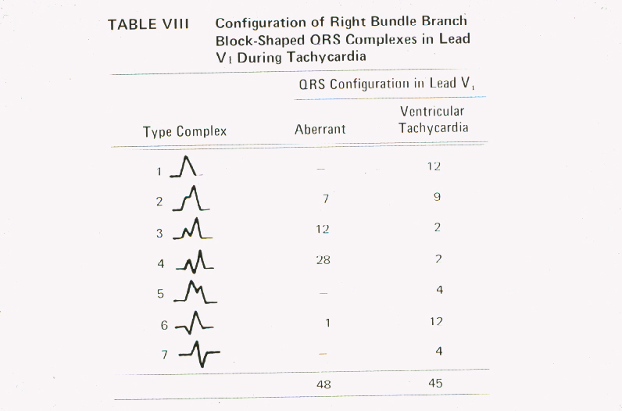

Slide 2
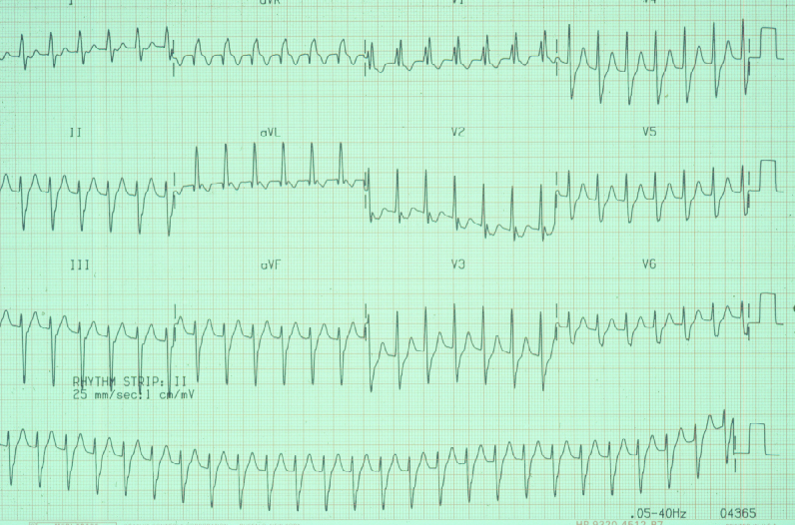

Slide 3
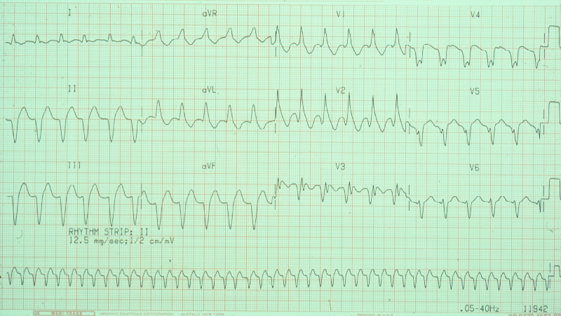

Slide 4
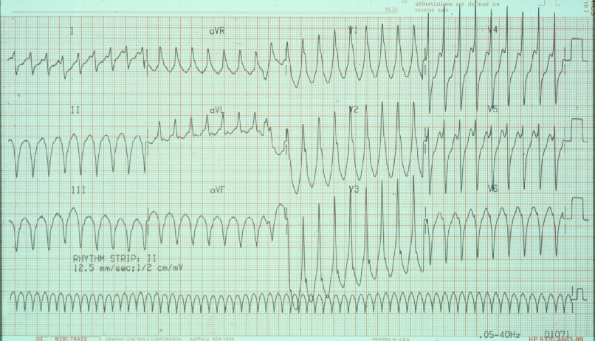

Slide 5
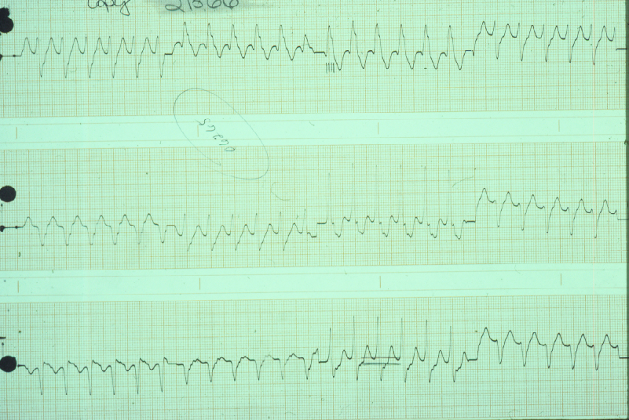

Slide 6
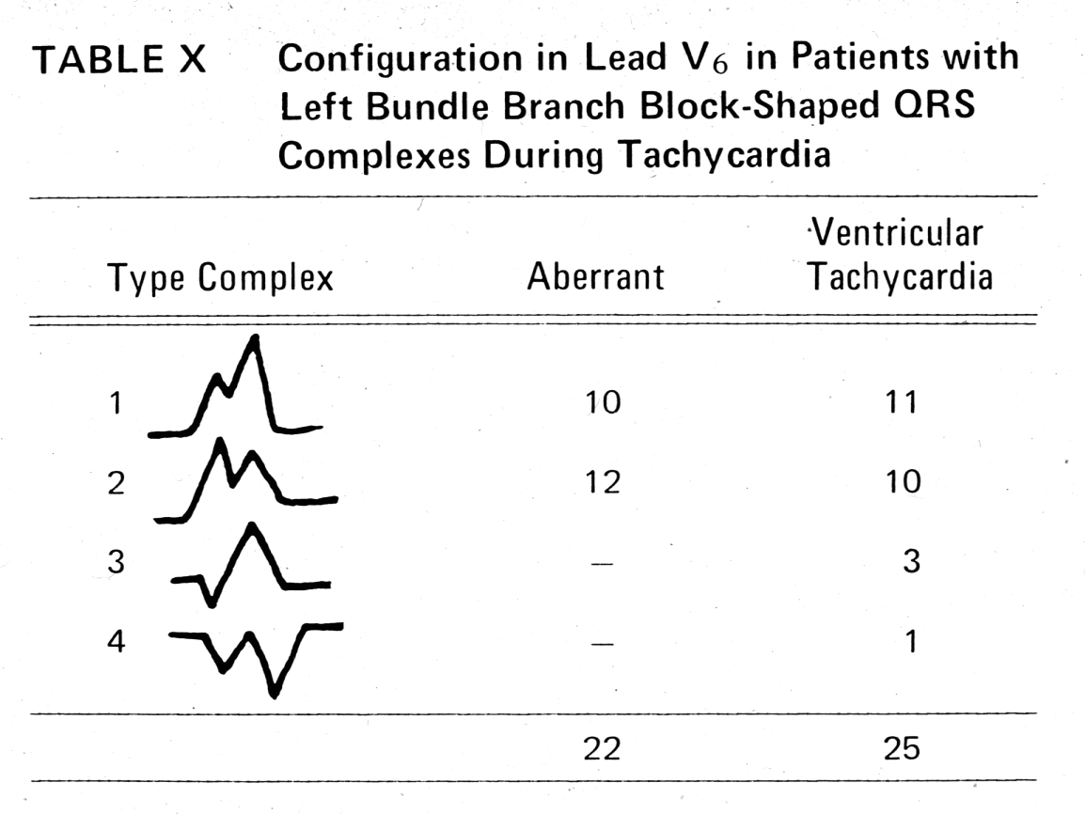

Slide 7
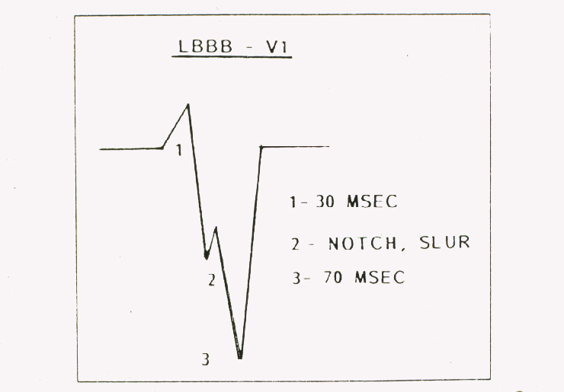

Slide 8
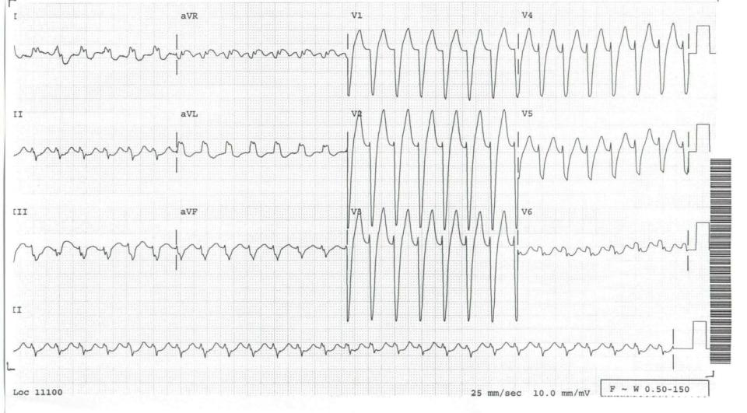

Slide 9
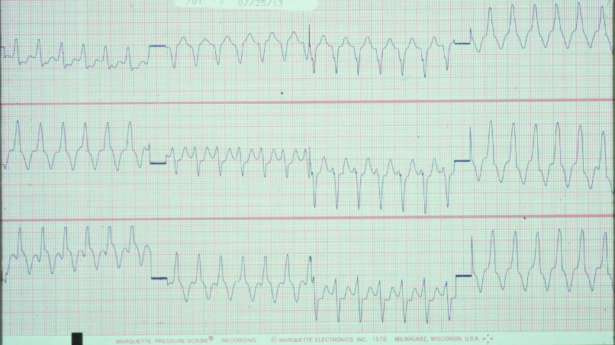

Slide 10
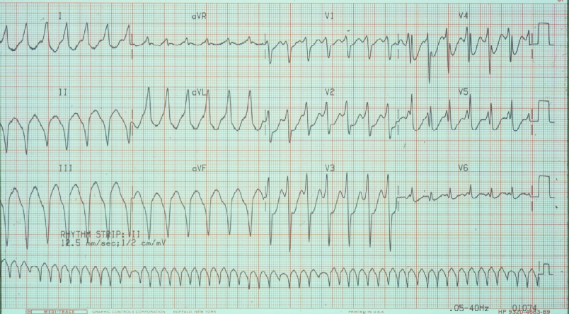

Slide 11
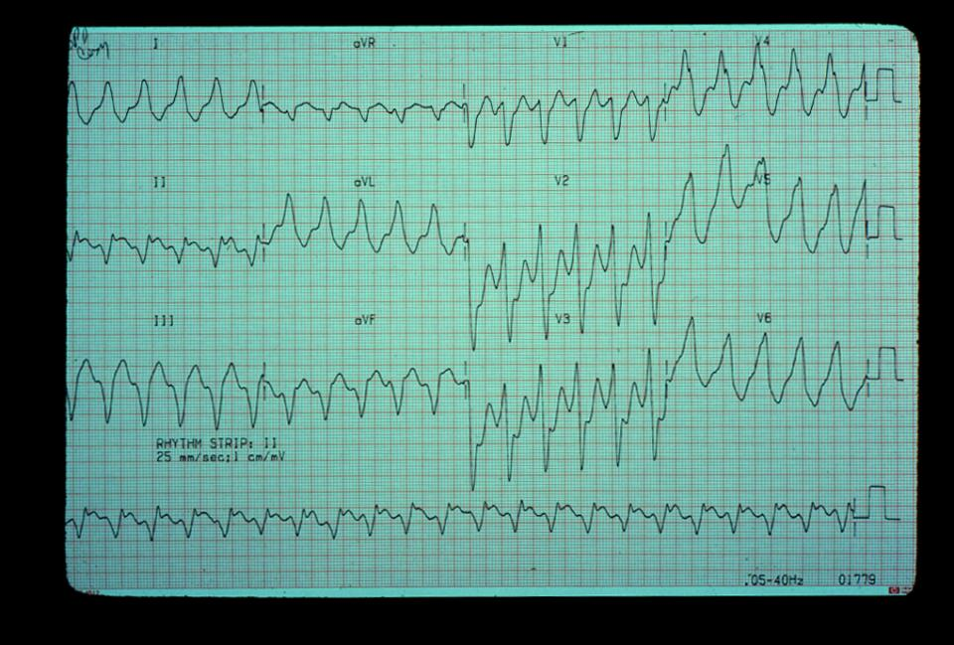

Slide 12
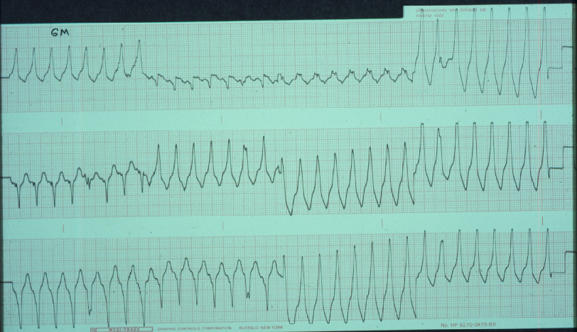

Slide 13
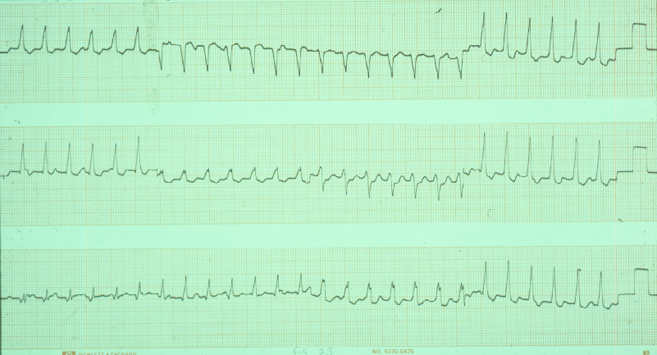

Slide 14
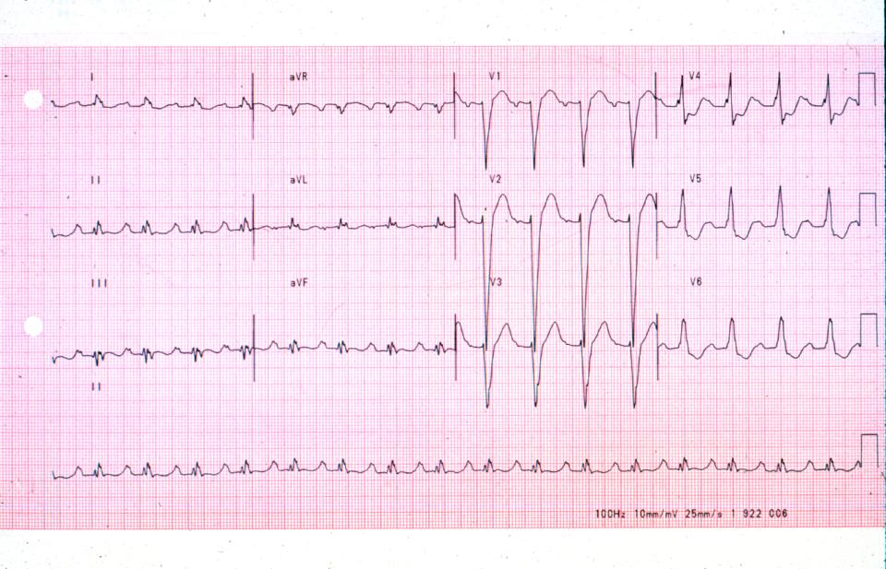

Slide 15
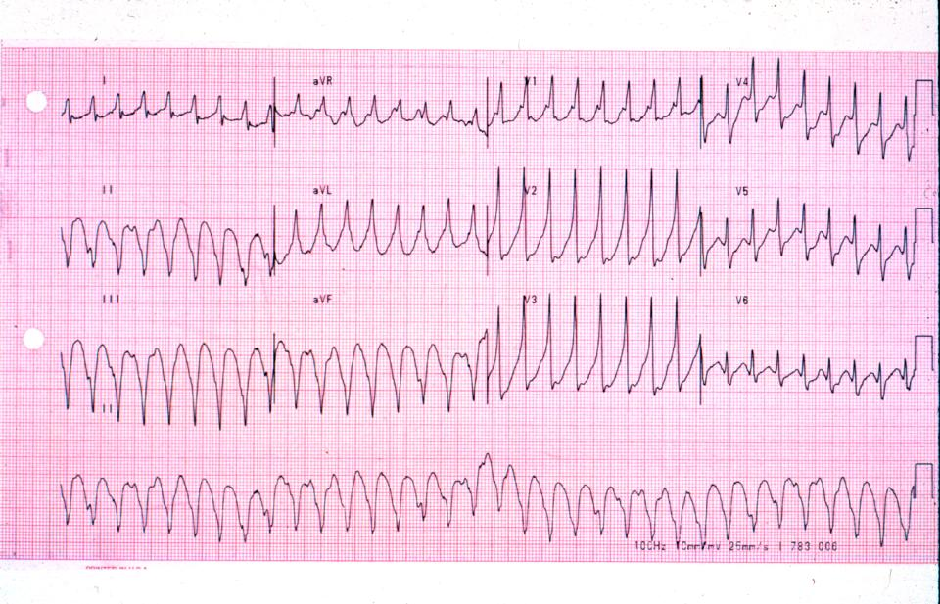

Slide 16
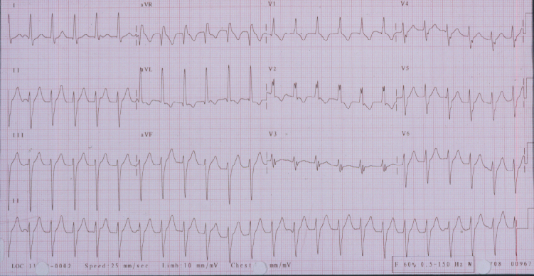

Slide 17
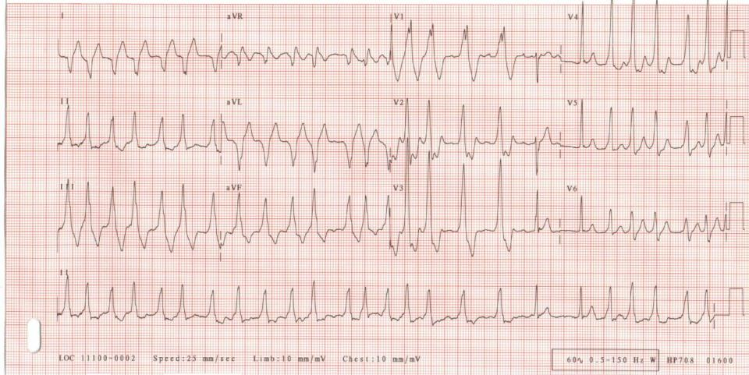

Slide 18
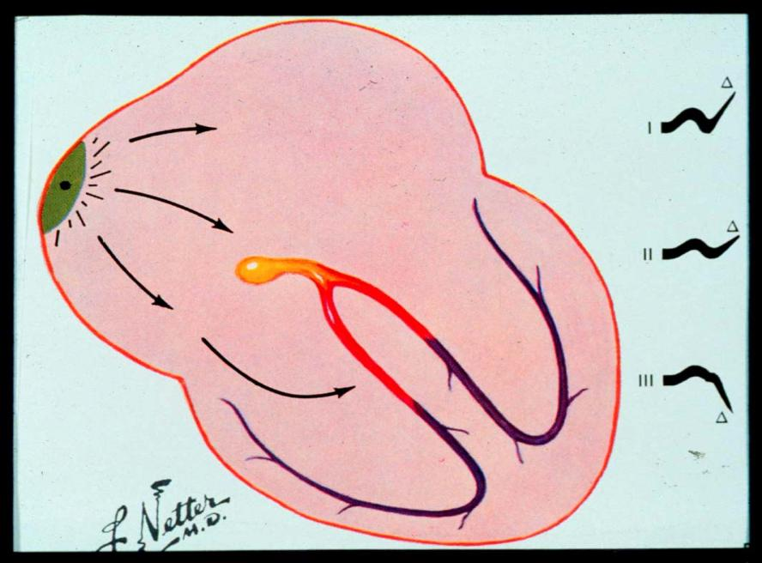

Slide 19
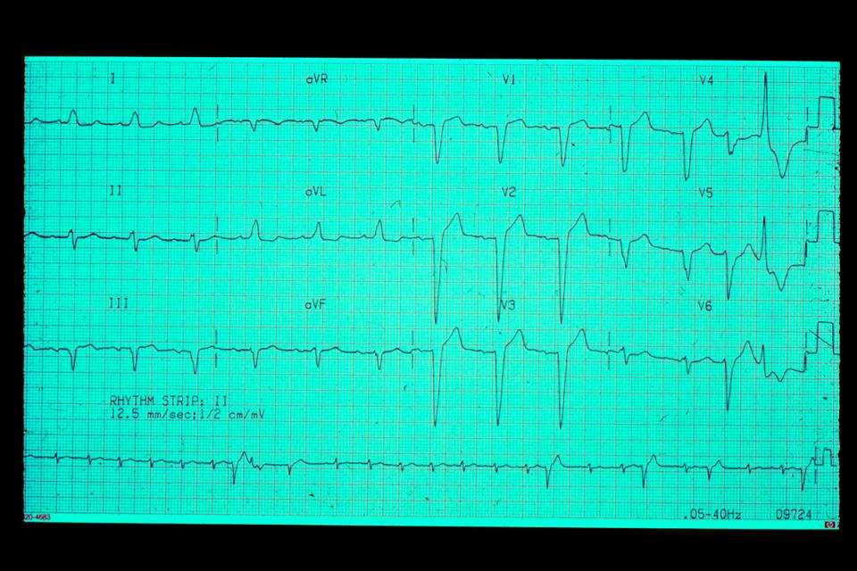

Slide 20
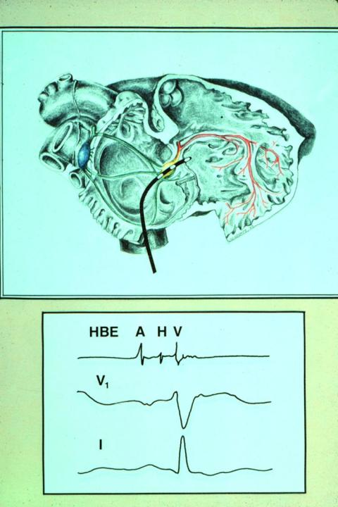

Slide 21
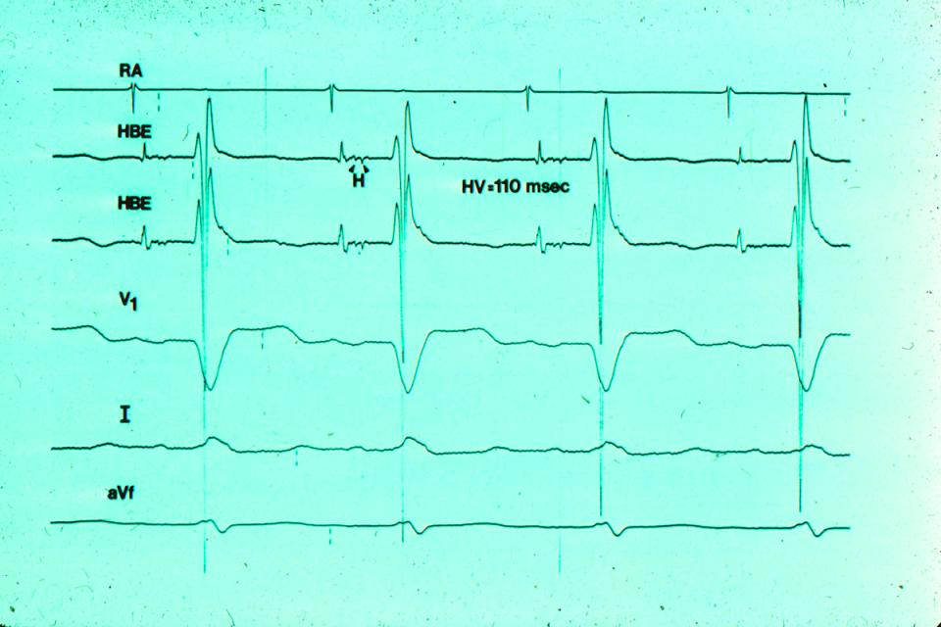

Slide 22
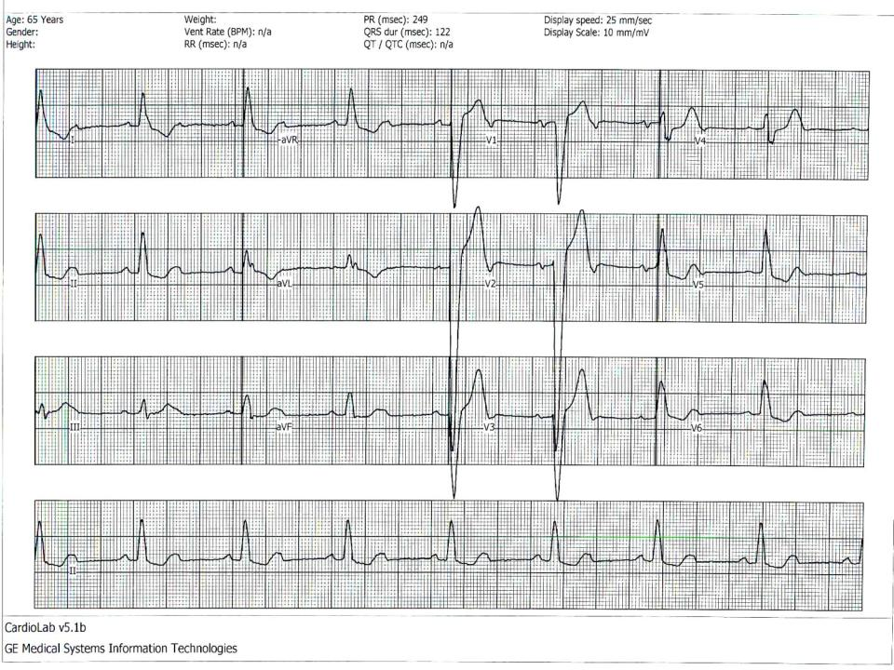

Slide 23
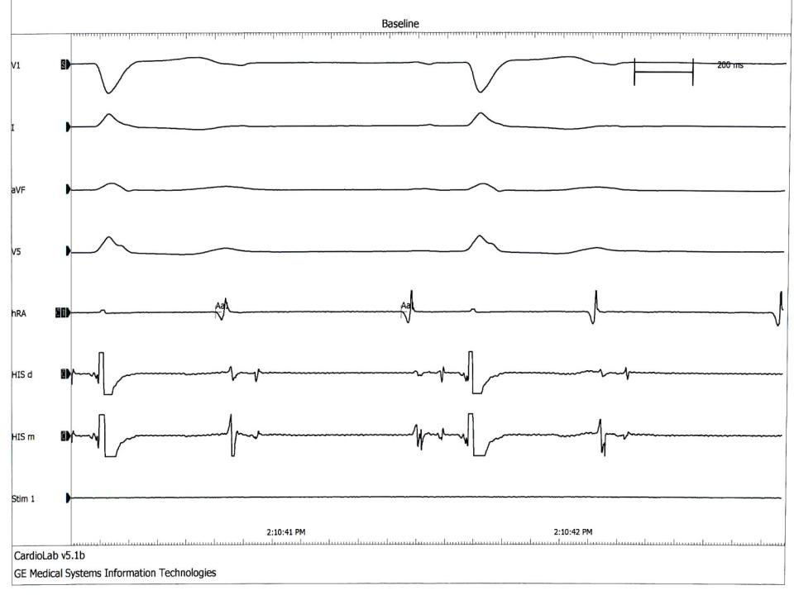

Slide 24
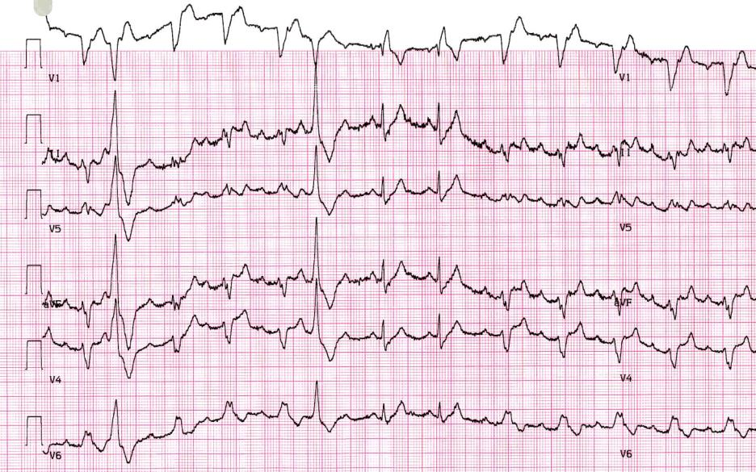

Slide 25
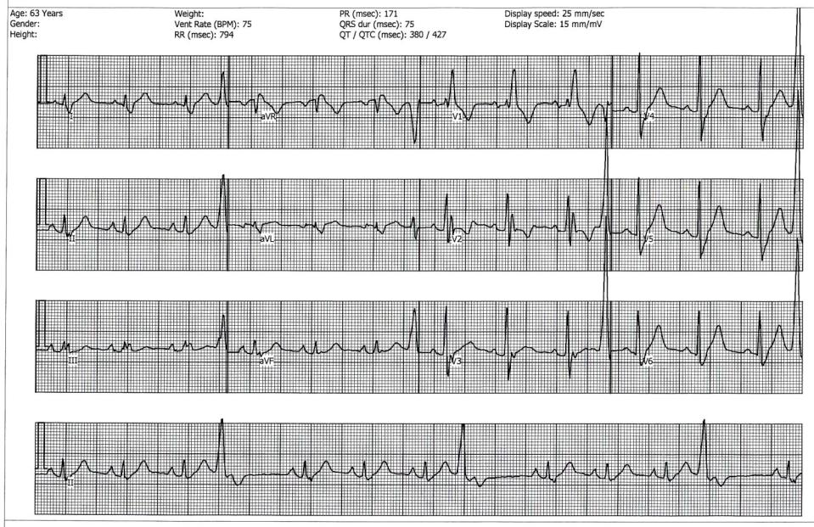

Slide 26
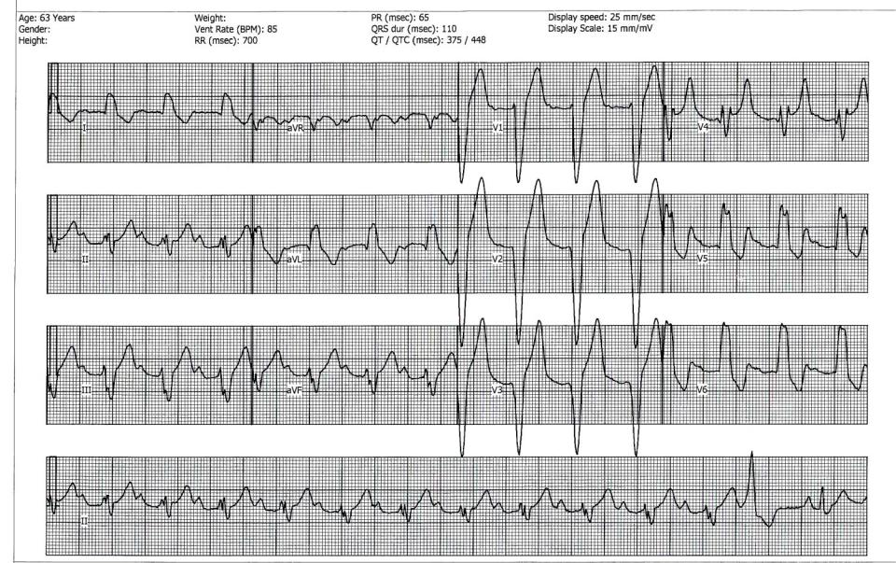

Slide 27
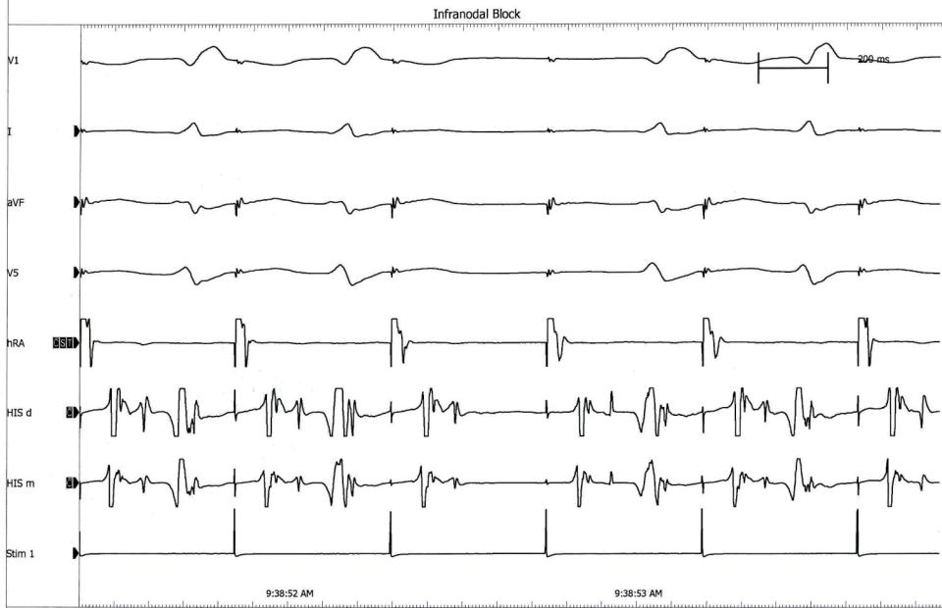

Slide 28
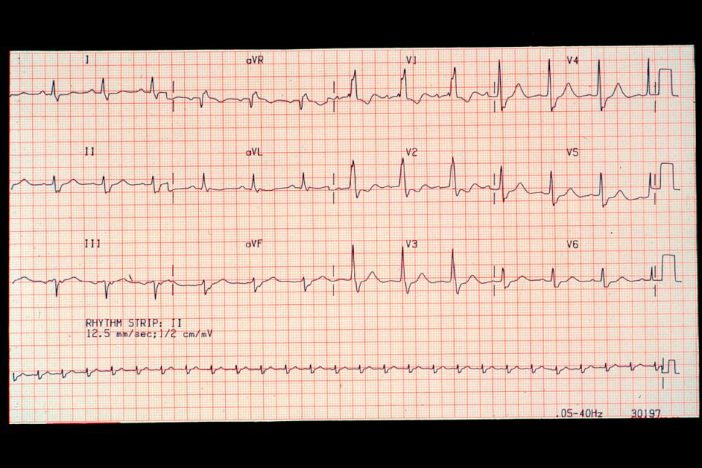

Slide 29
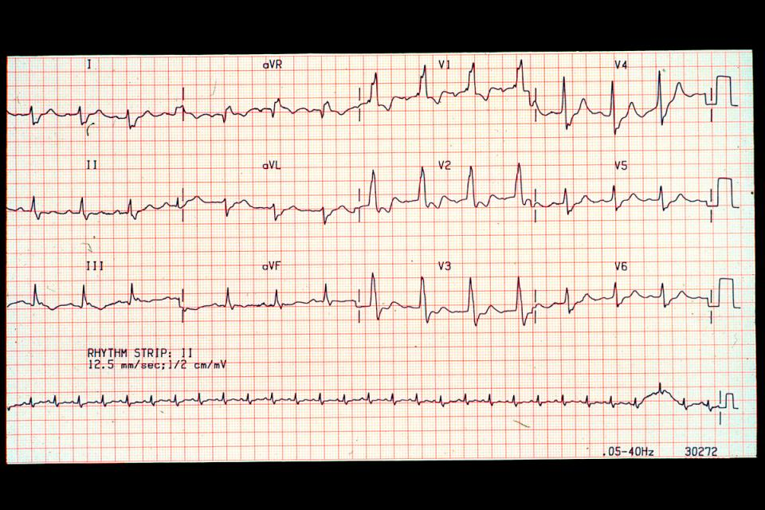

Slide 30
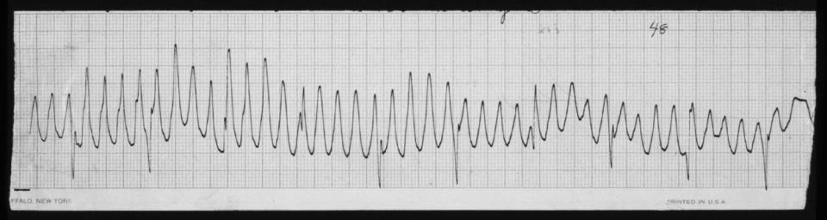

Slide 31
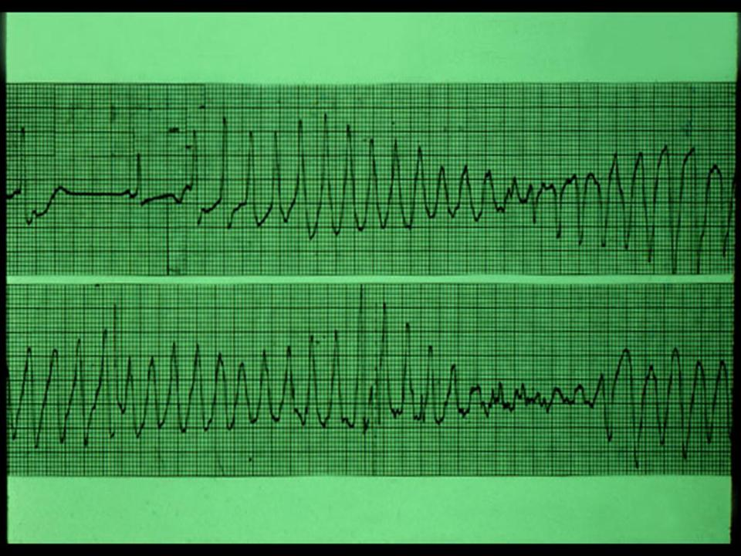

Slide 32
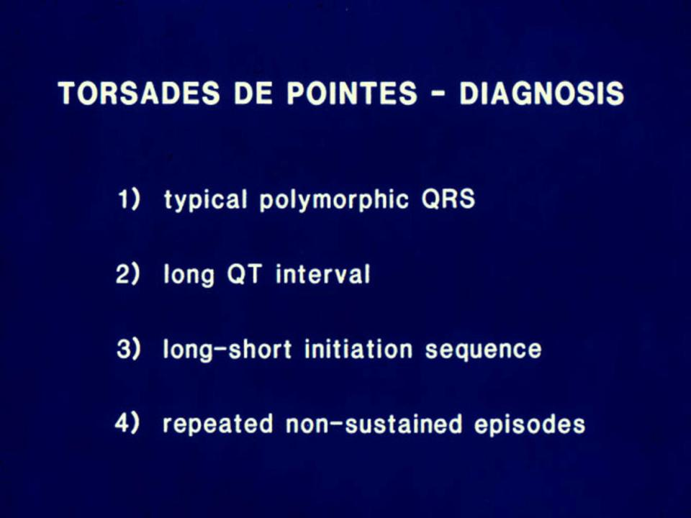

Slide 33
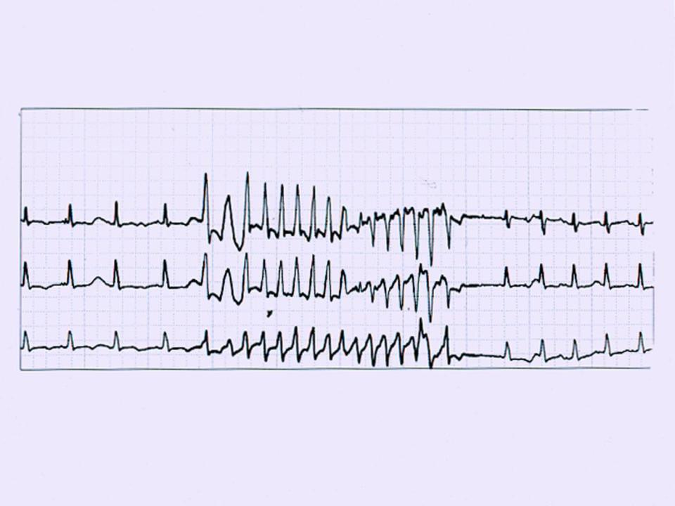

Slide 34
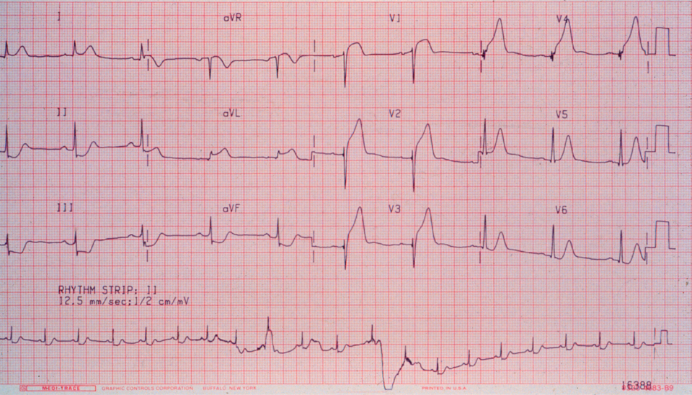

Slide 35
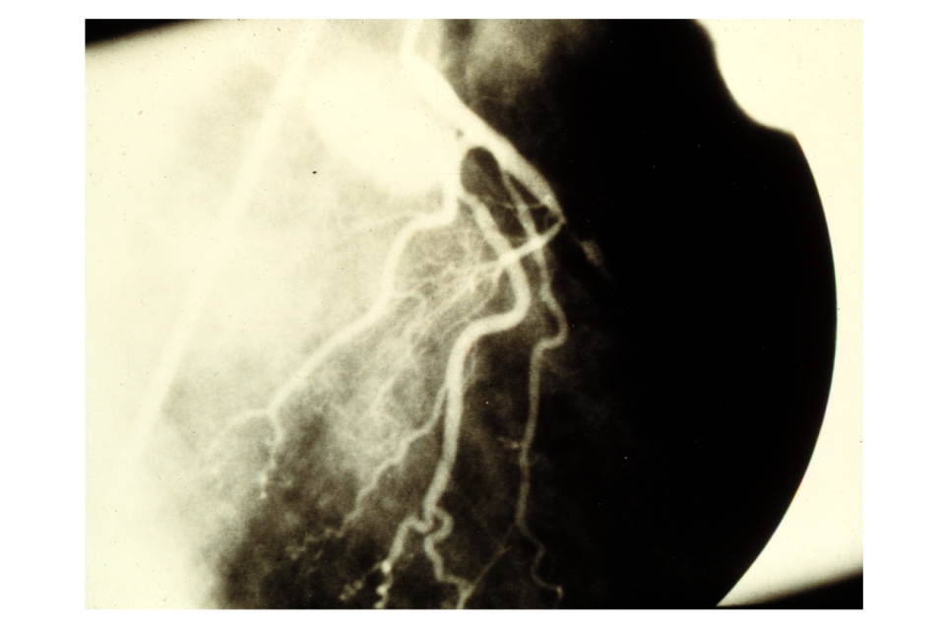

Slide 36
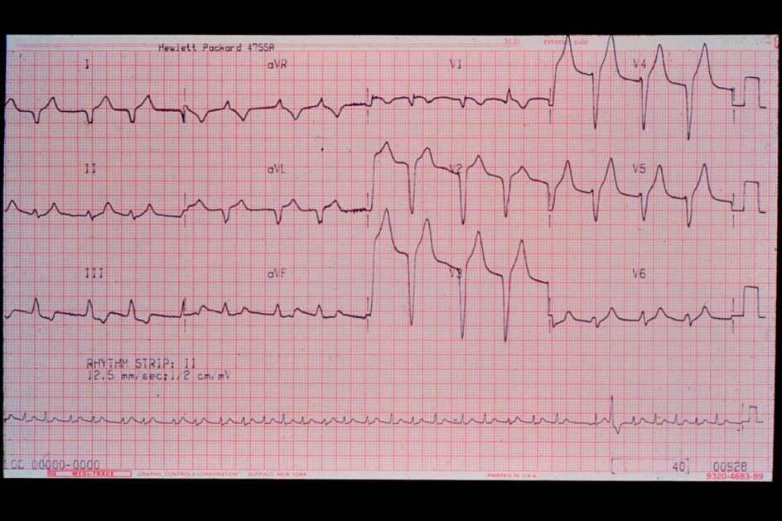

Slide 37
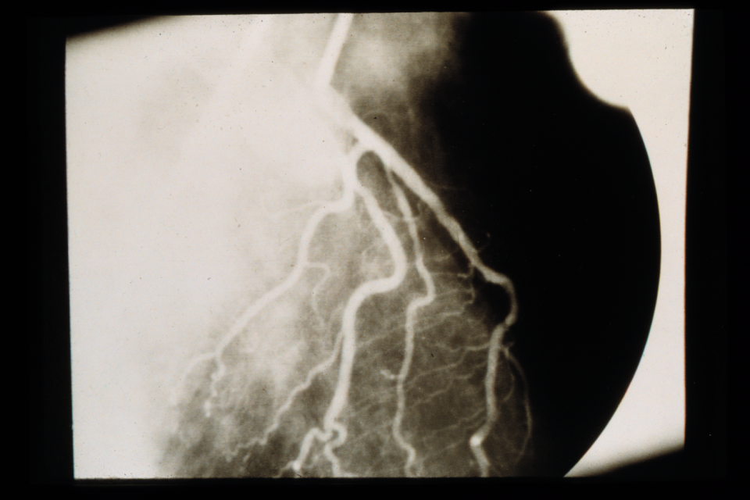

Slide 38
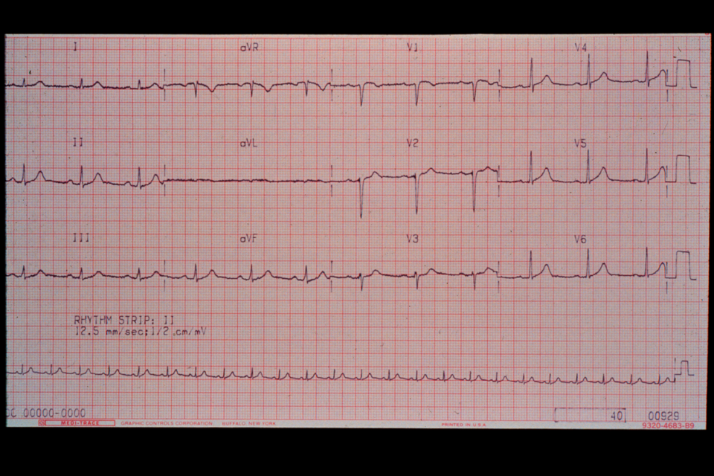

Slide 39
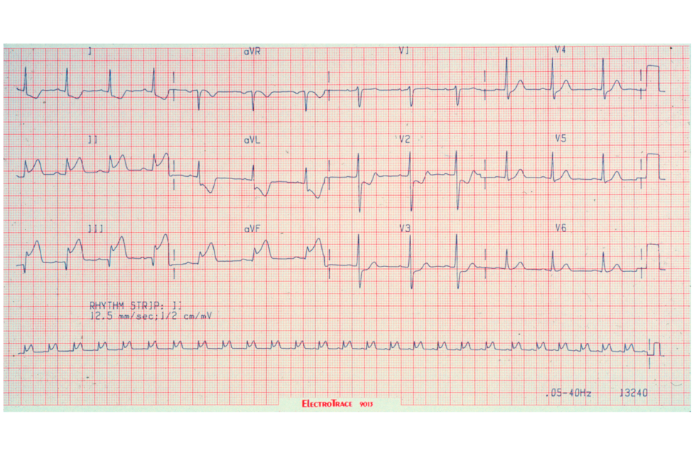

Slide 40
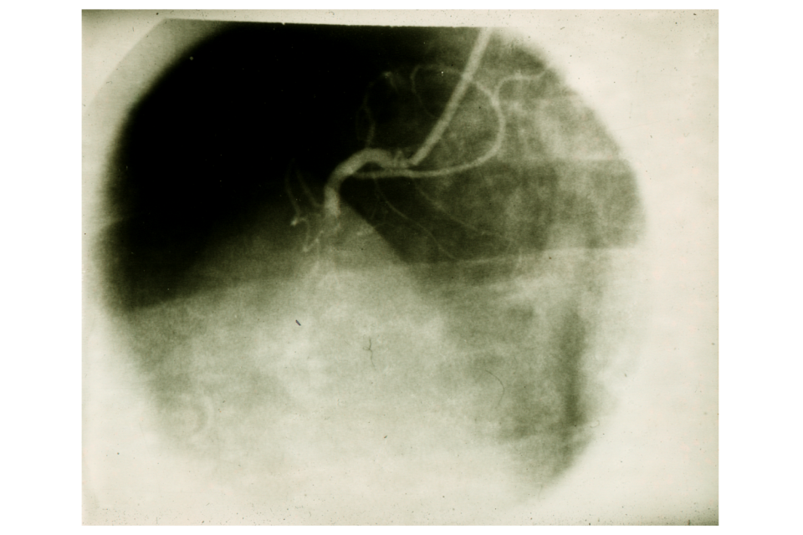

Slide 41
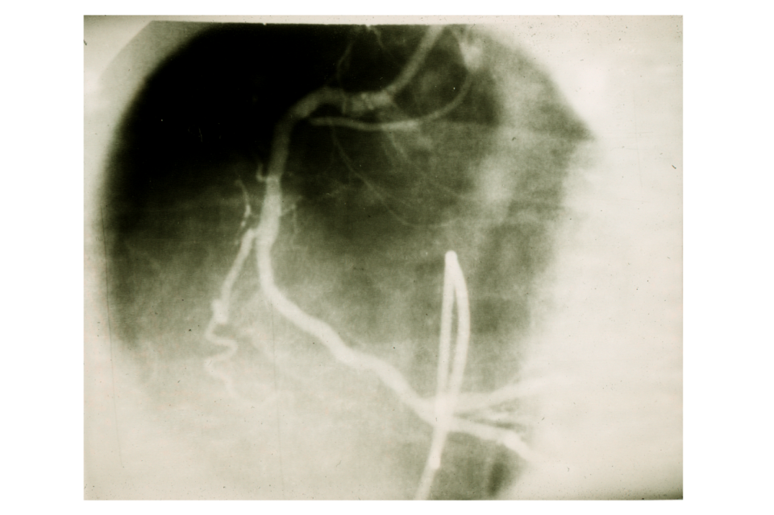

Slide 42
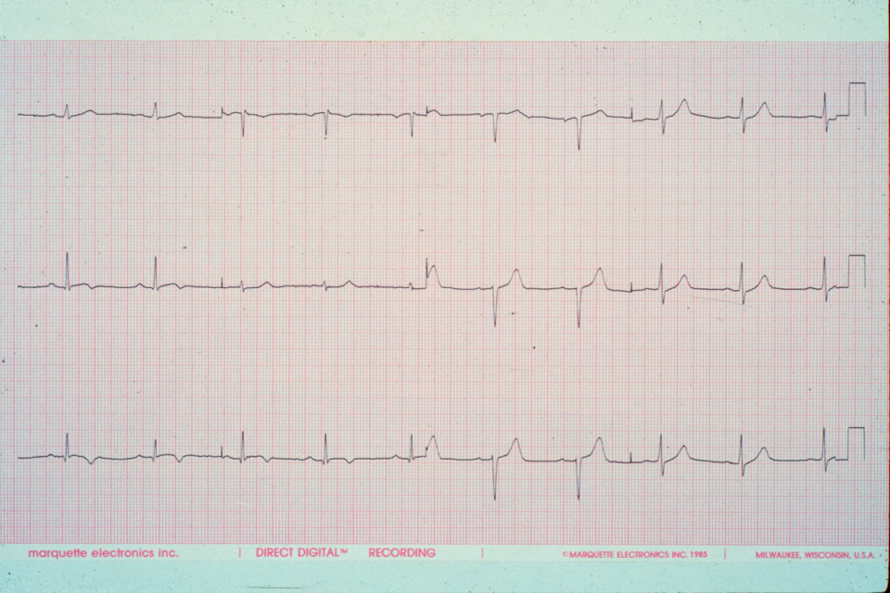

Slide 43
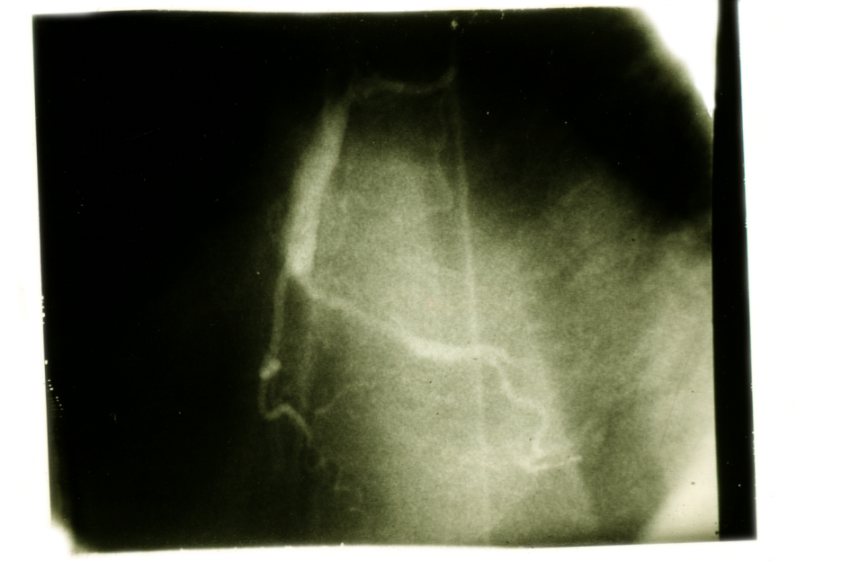

Slide 44
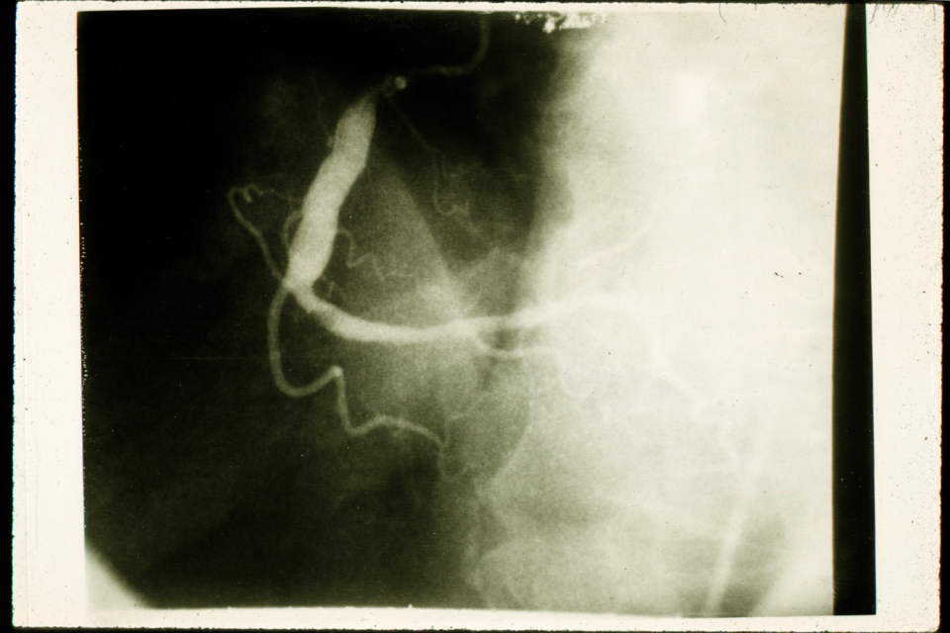

Slide 45
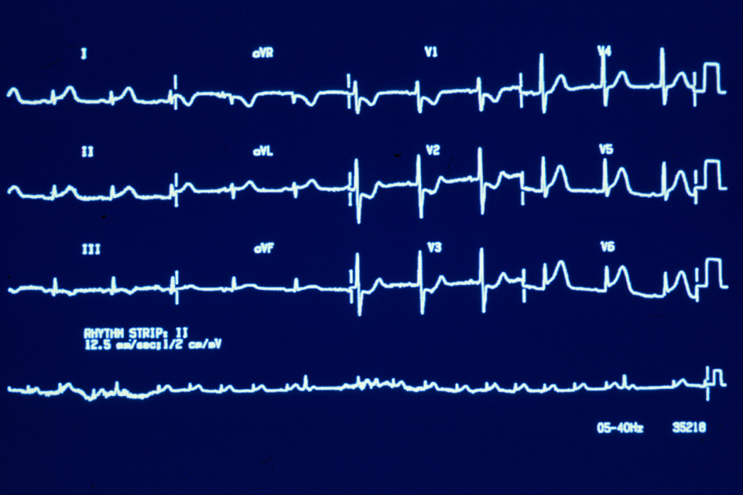

Slide 46
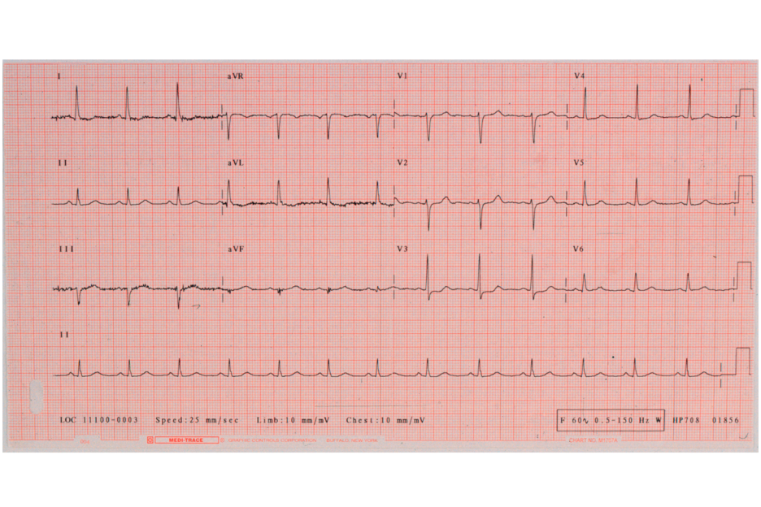

Slide 47
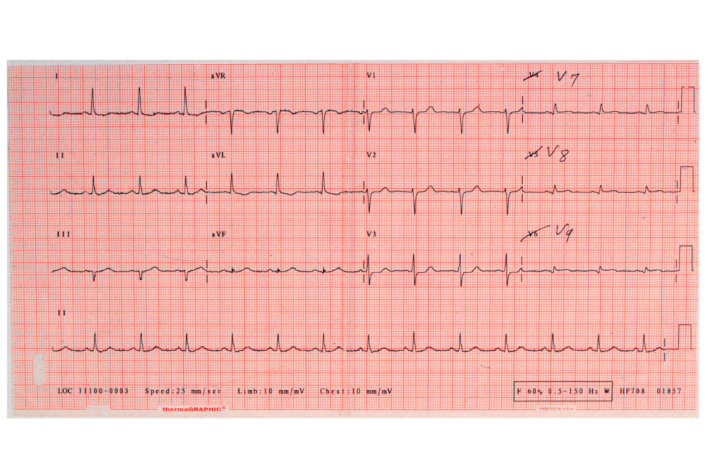

Slide 48
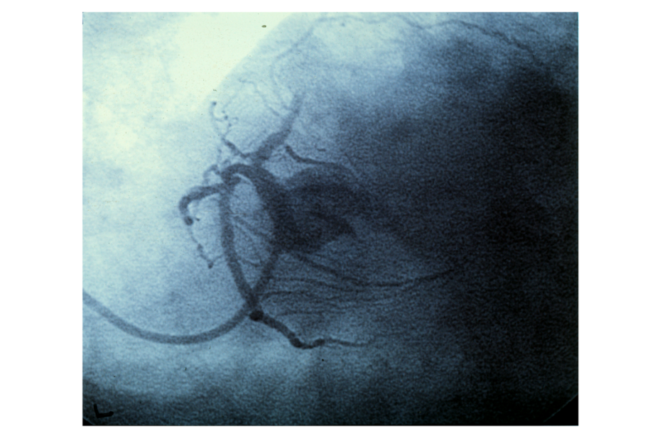

Slide 49
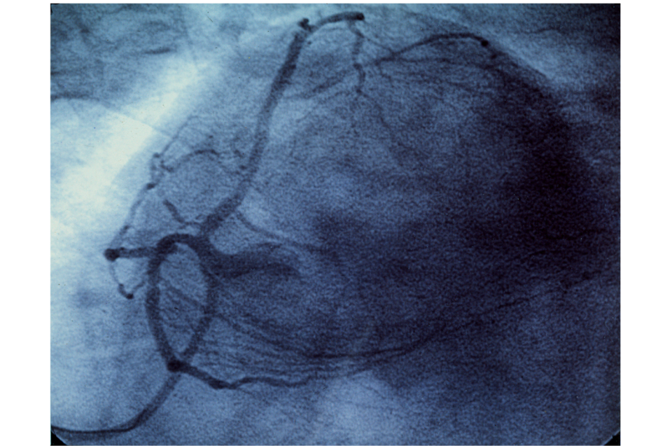

Slide 50
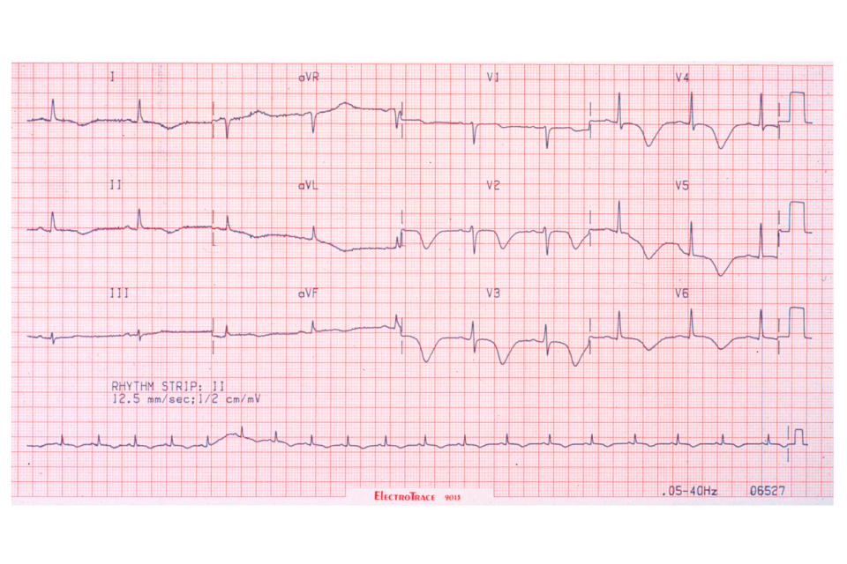

Slide 51


Slide 52


Slide 53


Slide 54


Slide 55


Slide 56


Slide 57


Slide 58


Slide 59


Slide 61


Slide 62


Slide 63


Slide 64


Slide 66


Slide 67
Current ECG Standard for Diagnosis of STEMI
ST Elevation in ≥ 2 contiguous leads

Slide 68
Considering the spatial relationships of their positive poles, which of the Chest Leads are contiguous ?
- 30 degrees
V6
V5
V4
+ 120 degrees
V3
V1
V2

Slide 69
Considering the spatial relationships of their positive poles, which of the Limb Leads are contiguous?
- 150 degrees
aVR
aVL
-30 degrees
I
+ 120 degrees
III
II
aVF

Slide 70

ECG DISPLAY FORMAT
-
ANATOMIC REFERENCE
ECG DISPLAY FORMAT
-
ANATOMIC REFERENCE
Transverse plane

Slide 71

ECG DISPLAY FORMAT
-
ANATOMIC REFERENCE
ECG DISPLAY FORMAT
-
ANATOMIC REFERENCE
Frontal plane
9

Slide 72
The 24 views of the standard 12-lead ECG during PTCA balloon occlusion in the
non-dominant LCX

Slide 73

00057

