Slide 1
My NCBI
NIH Public Access Policy and Maintaining Publications in eRA Commons

Slide 2
NIH Public Access Policy
The Policy ensures that the public has access to the published results of NIH-funded research. It requires scientists to submit final peer-reviewed journal manuscripts that arise from NIH funds to the digital archive PubMed Central upon acceptance for publication.
To help advance science and improve human health, the Policy requires that these papers are accessible to the public on PubMed Central no later than 12 months after publication.

Slide 3
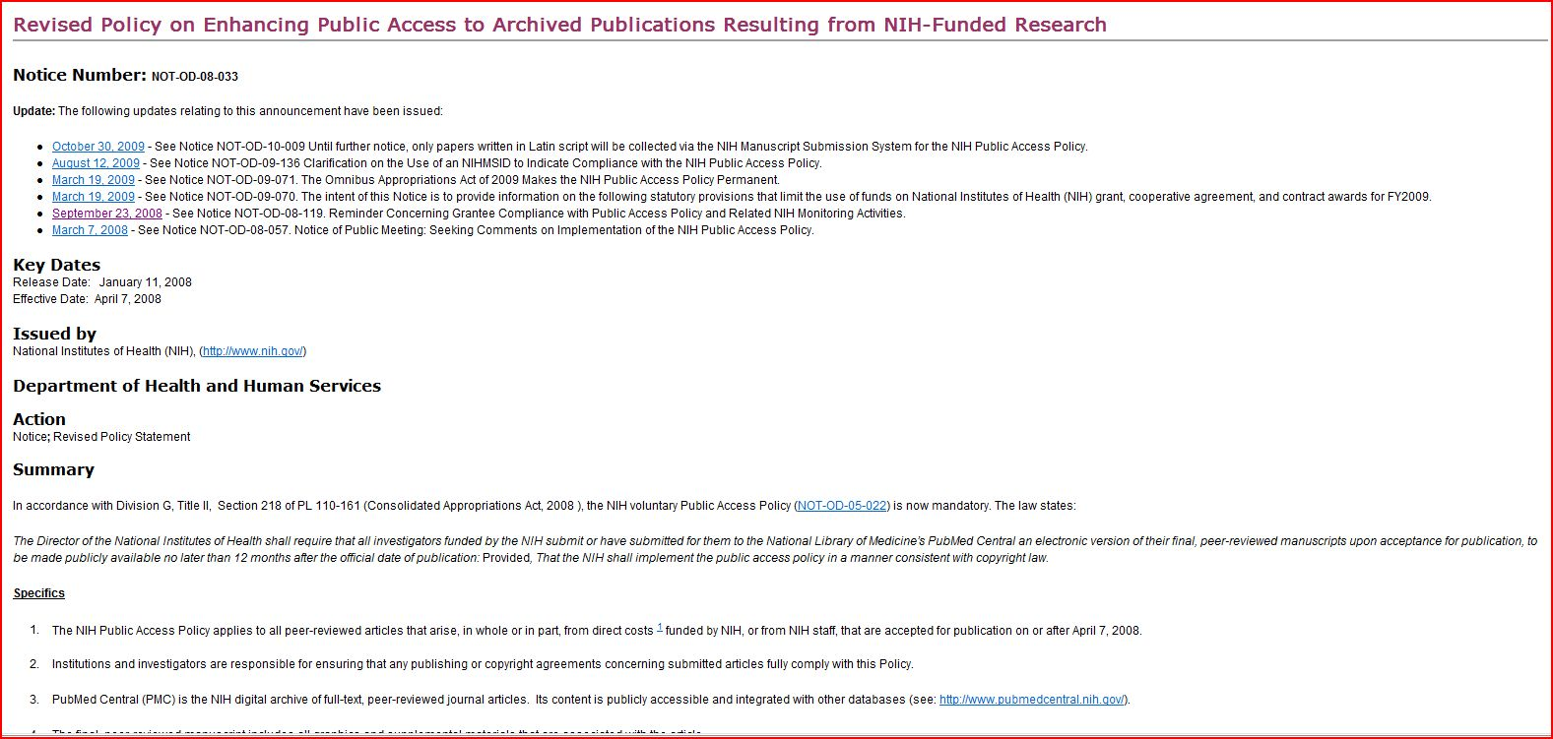
NOT-OD-08-033 January 11, 2008

Slide 4
Specifics
The NIH Public Access Policy applies to all peer-reviewed articles that arise, in whole or in part, from direct costs funded by NIH, or from NIH staff, that are accepted for publication on or after April 7, 2008.
Institutions and investigators are responsible for ensuring that any publishing or copyright agreements concerning submitted articles fully comply with this Policy.
PubMed Central (PMC) is the NIH digital archive of full-text, peer-reviewed journal articles. Its content is publicly accessible and integrated with other databases (see: http://www.pubmedcentral.nih.gov/).
The final, peer-reviewed manuscript includes all graphics and supplemental materials that are associated with the article.
Beginning May 25, 2008, anyone submitting an application, proposal or progress report to the NIH must include the PMC or NIH Manuscript Submission reference number when citing applicable articles that arise from their NIH funded research. This policy includes applications submitted to the NIH for the May 25, 2008 due date and subsequent due dates.

Slide 5
Compliance
Compliance with this Policy is a statutory requirement and a term and condition of the grant award and cooperative agreement, in accordance with the NIH Grants Policy Statement.

Slide 6
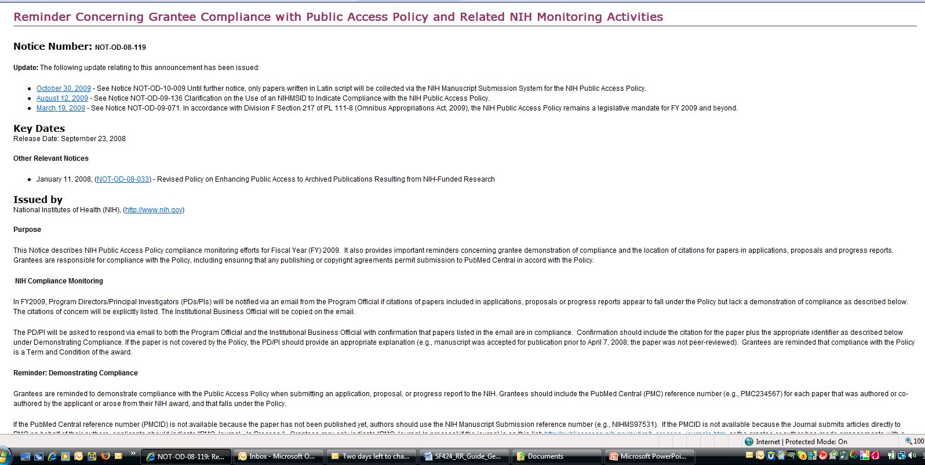
NOT-OD-033, Reminder September 23, 2008

Slide 7
NIH Compliance Monitoring
In FY2009, Program Directors/Principal Investigators (PDs/PIs) will be notified via an email from the Program Official if citations of papers included in applications, proposals or progress reports appear to fall under the Policy but lack a demonstration of compliance as described below. The citations of concern will be explicitly listed. The Institutional Business Official will be copied on the email.
The PD/PI will be asked to respond via email to both the Program Official and the Institutional Business Official with confirmation that papers listed in the email are in compliance. Confirmation should include the citation for the paper plus the appropriate identifier as described below under Demonstrating Compliance. If the paper is not covered by the Policy, the PD/PI should provide an appropriate explanation (e.g., manuscript was accepted for publication prior to April 7, 2008; the paper was not peer-reviewed). Grantees are reminded that compliance with the Policy is a Term and Condition of the award.

Slide 8
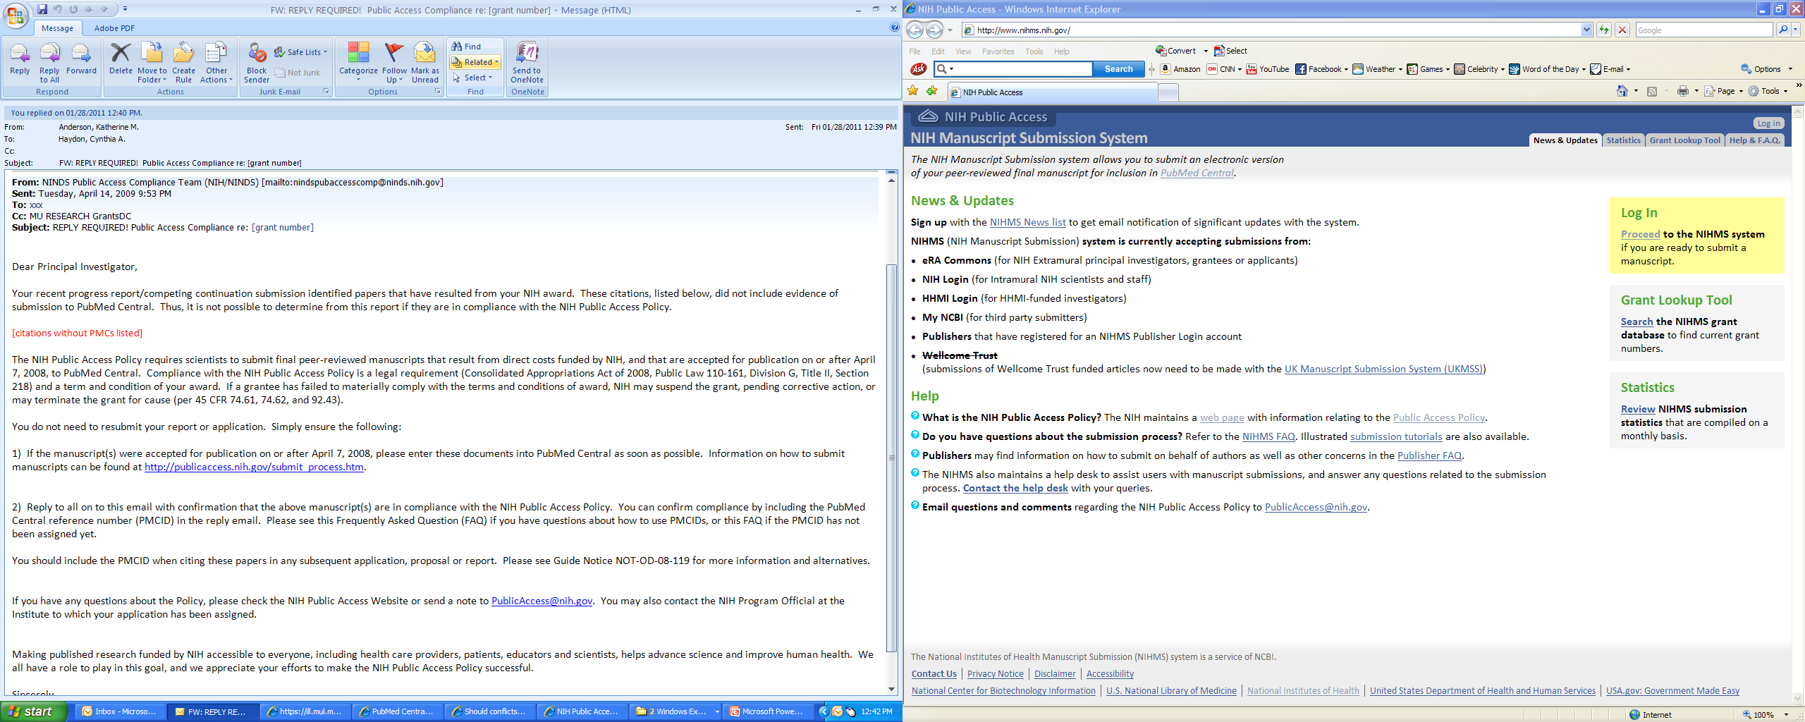
…an actual email

Slide 9
Demonstrating Compliance
Grantees are reminded to demonstrate compliance with the Public Access Policy when submitting an application, proposal, or progress report to the NIH. Grantees should include the PubMed Central (PMC) reference number (e.g., PMC234567) for each paper that was authored or co-authored by the applicant or arose from their NIH award, and that falls under the Policy.
If the PubMed Central reference number (PMCID) is not available because the paper has not been published yet, authors should use the NIH Manuscript Submission reference number (e.g., NIHMS97531). If the PMCID is not available because the journal submits articles directly to PMC on behalf of their authors, applicants should indicate "PMC Journal - In Process."
NIH expects citations in an application, proposal or report to include the most up-to-date information concerning the status of compliance with the Public Access Policy.

Slide 10
Determine Applicability
The Policy applies to any manuscript that:
Is peer-reviewed;
And, is accepted for publication in a journal on or after April 7, 2008;
And, arises from:
Any direct funding¹ from an NIH grant or cooperative agreement active in Fiscal Year 2008 or beyond, or;
Any direct funding from an NIH contract signed on or after April 7, 2008, or;
Any direct funding from the NIH Intramural Program, or;
An NIH employee
Until further notice, papers written in scripts other than Latin (e.g., Russian, Japanese) cannot be processed by the NIHMS. These papers are not required to be posted on PubMed Central and do not require evidence of compliance on applications, proposals or reports. The NIHMS continues to process papers written in Latin (Roman) script that contain characters and fonts used in standard mathematical notation.
Authors may submit final peer-reviewed manuscripts accepted before April 7, 2008 that arise from NIH funds, if they have appropriate copyright permission.
Applications, Proposals and Reports must include evidence of compliance with the NIH Public Access Policy for all applicable papers that are authored by the Principal Investigator (PI) or arose from the PI’s NIH funds.
¹ "Directly" funded means costs that can be specifically identified with a particular project or activity. See NIH Grants Policy Statement, Rev. 12/2003.

Slide 11
Address Copyright
Before you sign a publication agreement or similar copyright transfer agreement, make sure that the agreement allows the paper to be posted to PubMed Central (PMC) in accordance with the NIH Public Access Policy.
Final, peer-reviewed manuscripts must be posted to the NIHMS upon acceptance for publication, and be made publicly available on PMC no later than 12 months after the official date of publication.

Slide 12
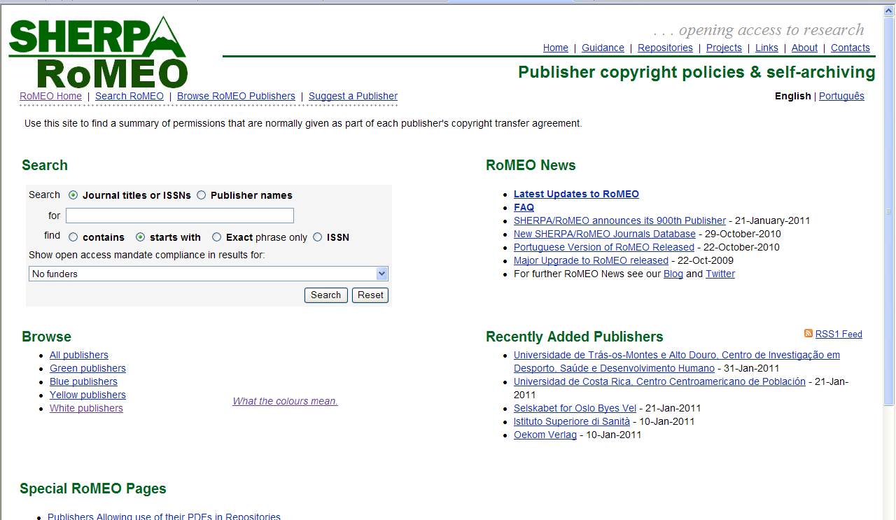
Publisher copyright policies & self-archiving http://www.sherpa.ac.uk/romeo/index.php?fIDnum=|&la=en

Slide 13
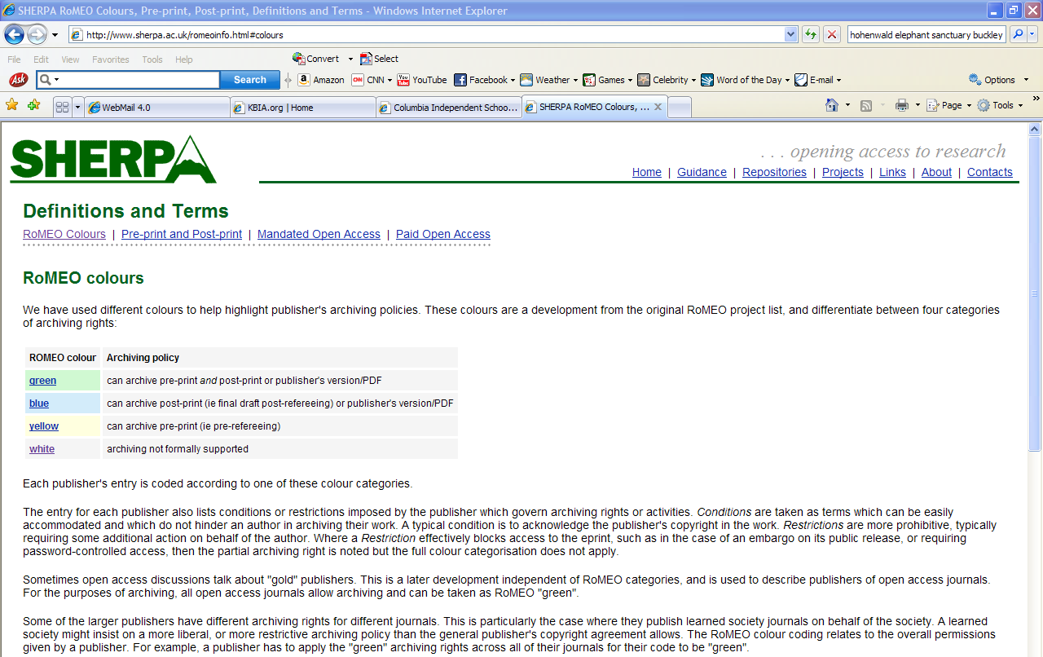
What the colors mean

Slide 14
Submission Methods
Method A Journal deposits final published articles in PubMed Central without author involvement
Method B Author asks publisher to deposit specific final published article in PMC
Method C Author deposits final peer-reviewed manuscript in PMC via the NIHMS
Method D Author completes submission of final peer-reviewed manuscript deposited by publisher in the NIHMS

Slide 15
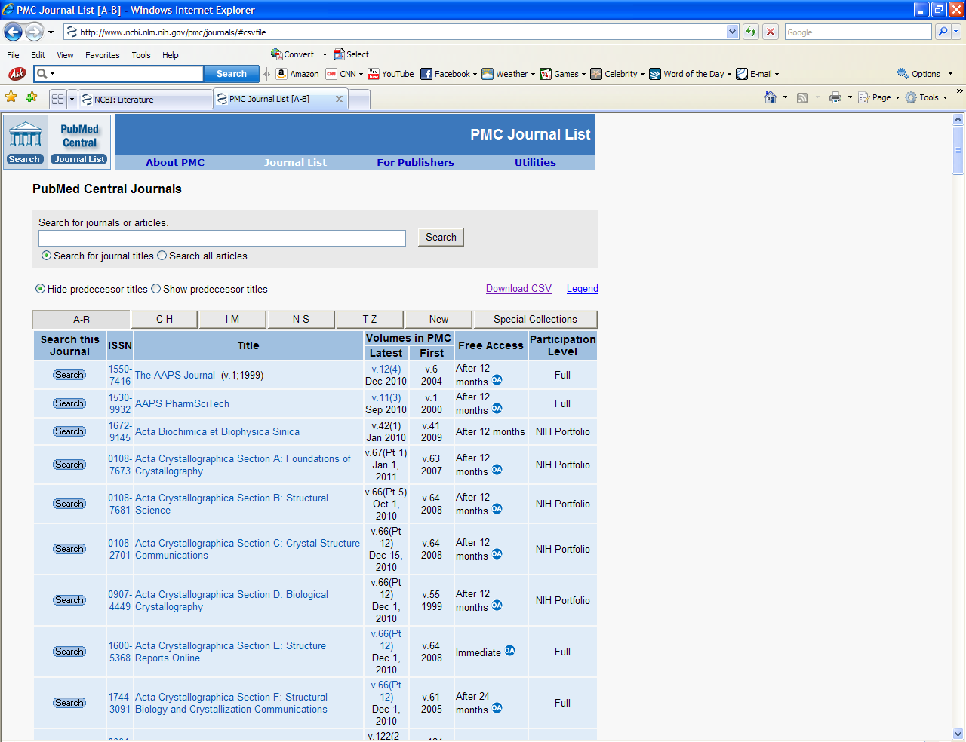
Method A Journals (over 1,100) http://www.ncbi.nlm.nih.gov/pmc/journals/

Slide 16
Method B Journals
Some publishers have an arrangement with NIH to deposit individual final published articles in PubMed Central (PMC) on a case-by-case basis. These journals do not automatically deposit every NIH-funded paper in PMC. Rather, the author can choose to arrange with the journal for the deposit of a specific article; this usually involves choosing the journal’s fee-based open access option for publishing that article.
The publisher programs that have this arrangement with NIH are:
ACS AuthorChoice
APA Open Access
BMJ Unlocked
Cambridge Open Access
European Society of Endocrinology Open Access
IUCr Open Access
Maney MORE Open Choice
NPG Open Access
Portland Press Opt2Pay
Royal College of Psychiatrists Open Access
SAGE Open
Society for Endocrinology Open Access
Society for Reproduction and Fertility Open Access
Springer Open Choice
Taylor & Francis iOpenAccess
Wiley-Blackwell Online Open

Slide 17
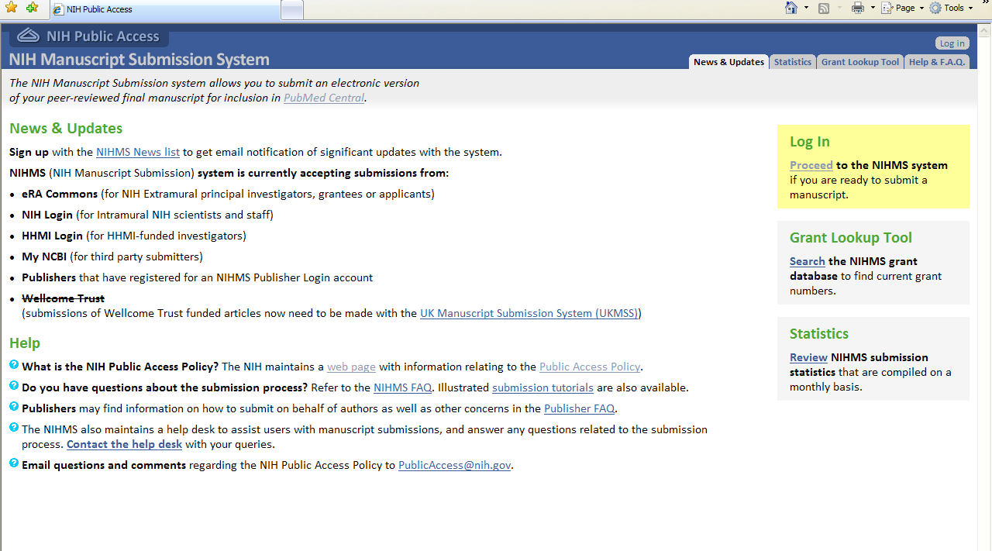
Method C and D Journals-www.nihms.nih.gov

Slide 18
What is NCBI?
National Center for Biotechnology Information, a division of the National Library of Medicine at the National Institutes of Health
In 2010, In the interest of easing investigators’ bibliography management, improving data quality, and ensuring compliance with the NIH Public Access Policy (http://publicaccess.nih.gov/), eRA Commons partnered with NCBI (http://www.ncbi.nlm.nih.gov/) to link NCBI’s personal online tool, “My NCBI,” to Commons. My NCBI offers an online portal—“My Bibliography”(http://www.ncbi.nlm.nih.gov/sites/myncbi/)—for users to maintain and manage a list of all types of their authored works, such as articles, presentations and books.

Slide 19
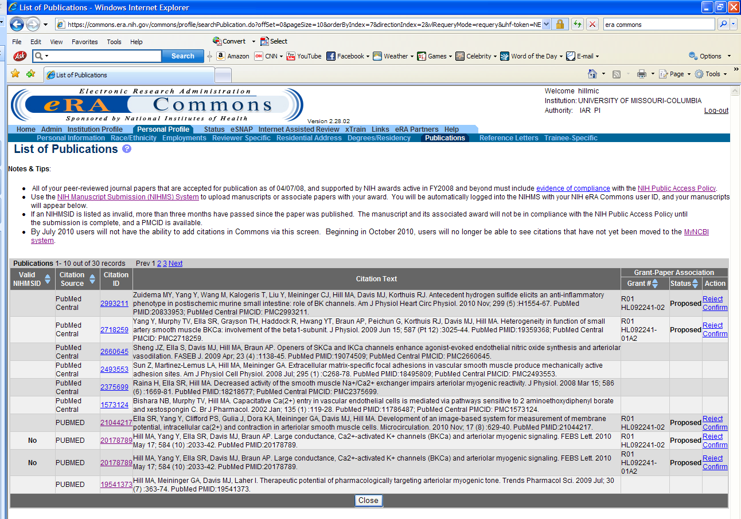
PIs now need a myNCBI account. The best way to create one is to start in eRA Commons:

Slide 20
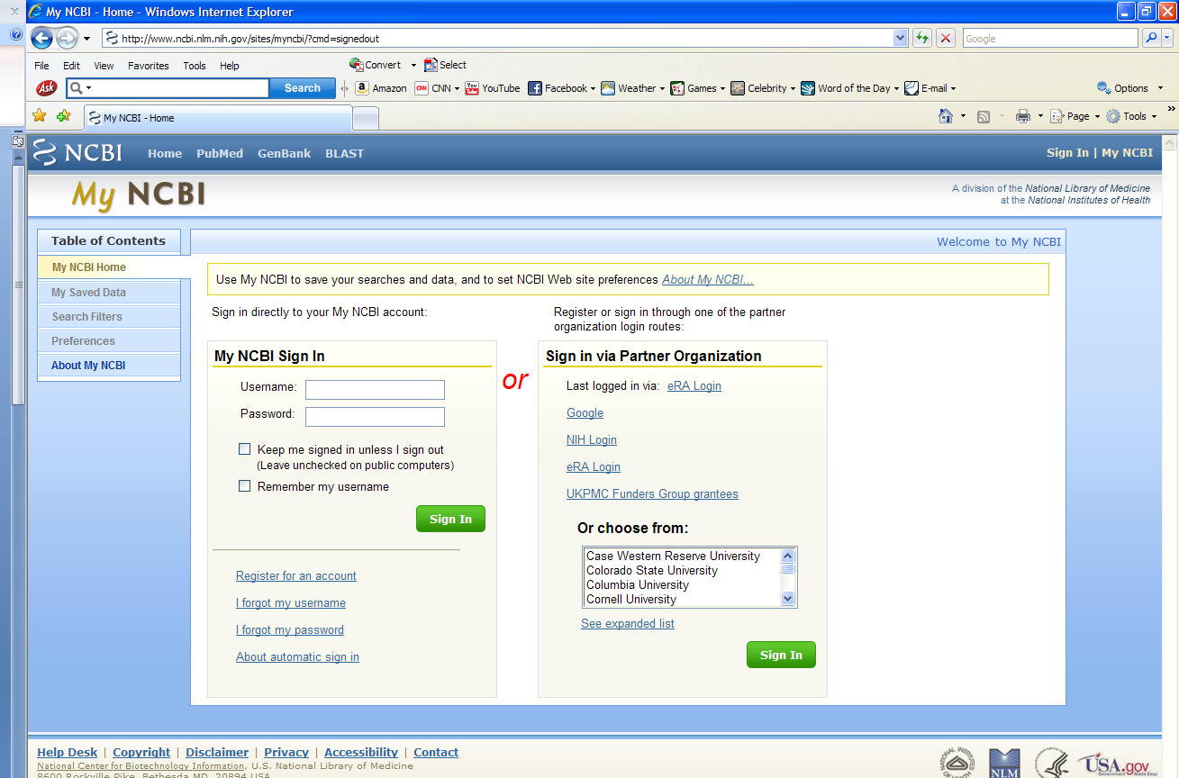
Sign in via Partner Organization

Slide 21
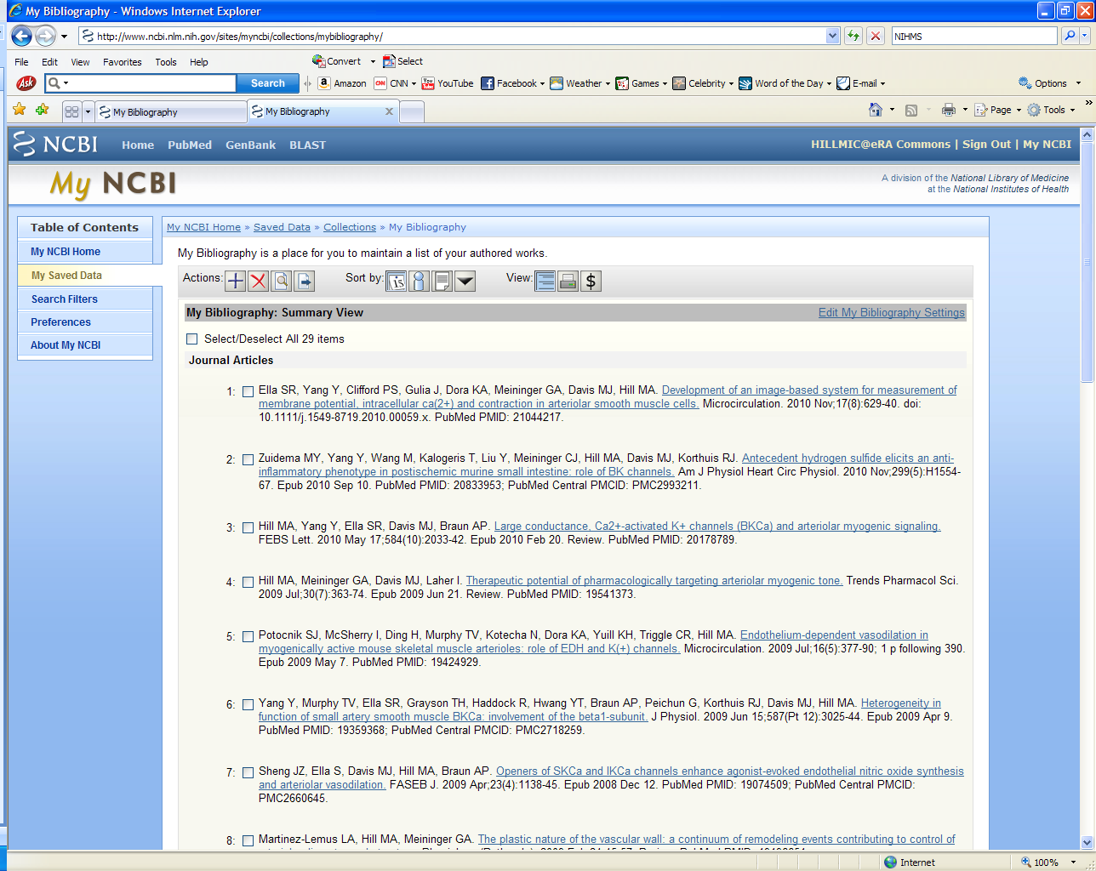
Go to Saved Data, and then to my Bibliography Click “+” to add manually or through PubMed Click “$” for view that links to funding and notes Public Access compliance Click “Edit My Bibliography Settings” to add a delegate

Slide 22
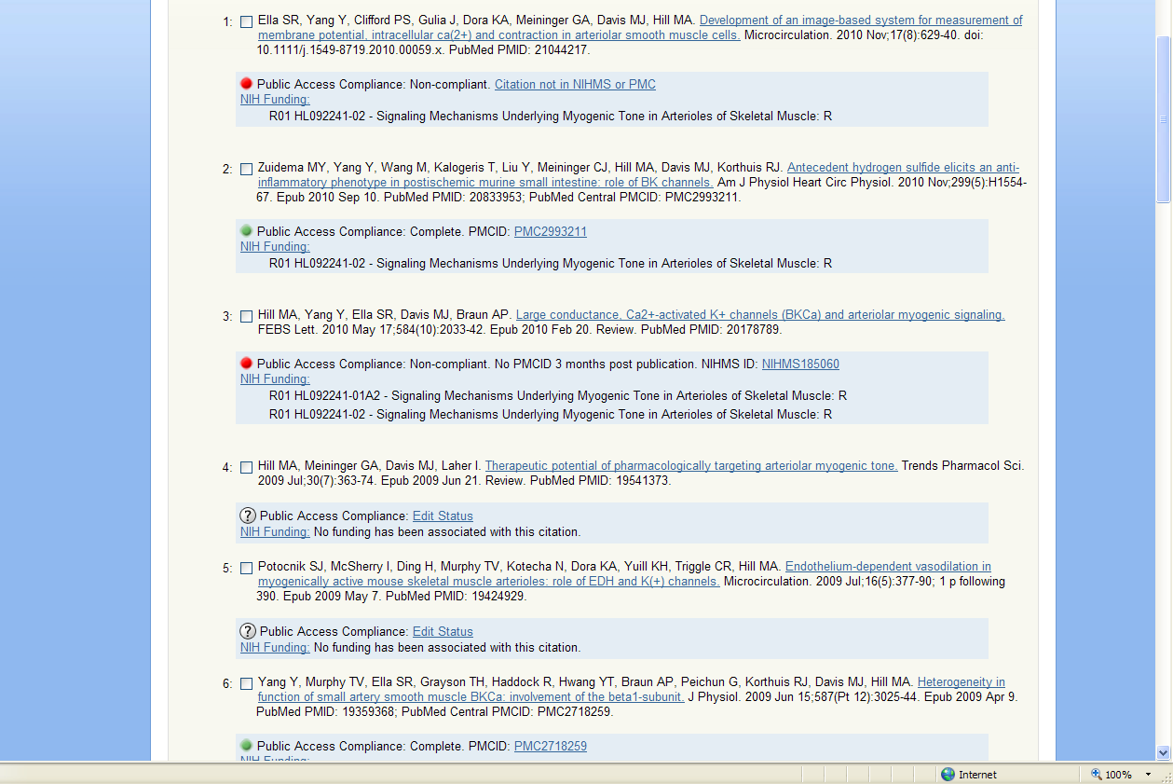
Green indicates compliance; Red, non-compliance; Yellow, in process. You can also associate publications with funding or indicate that it was not the result of NIH funding support.

Slide 23
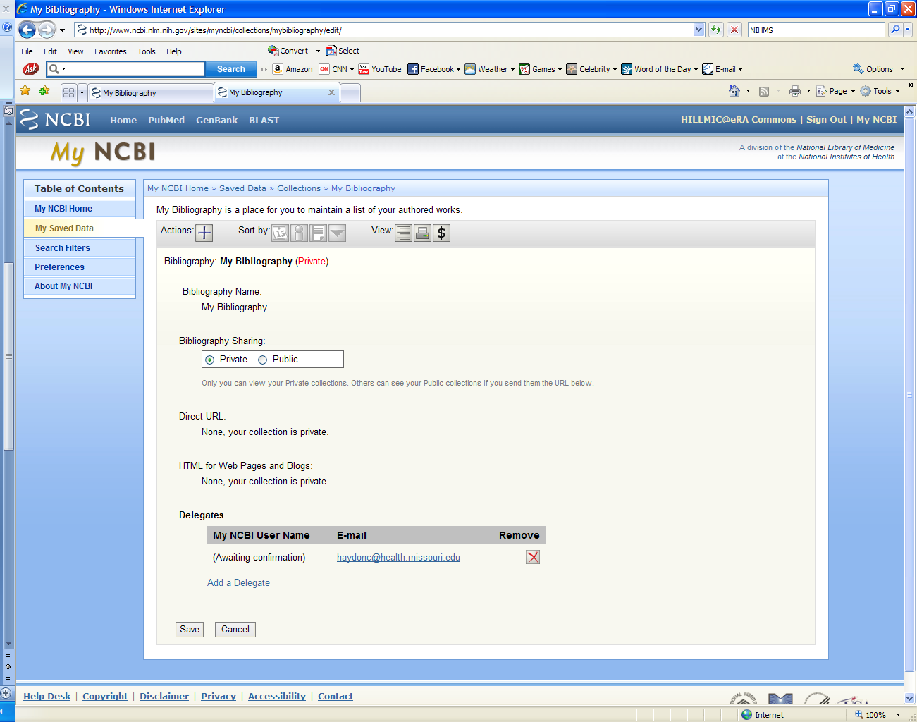
A PI can name a delegate to help manage this process by adding email addresses, here.

Slide 24
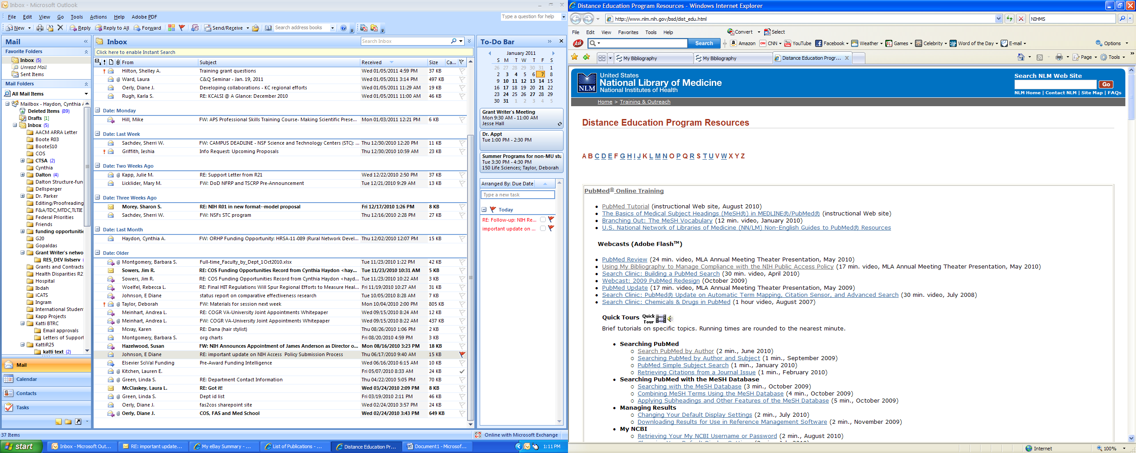
Useful tutorial: Using My Bibliography to Manage Compliance with NIH Public Access Policy : http://www.nlm.nih.gov/bsd/dist_edu.html

Slide 25
For more help with Public Access and My NCBI
Kate Anderson
Specialized Services Librarian
212 Health Sciences Library
(573) 882-6143
andersonkat@health.missouri.edu

Slide 26
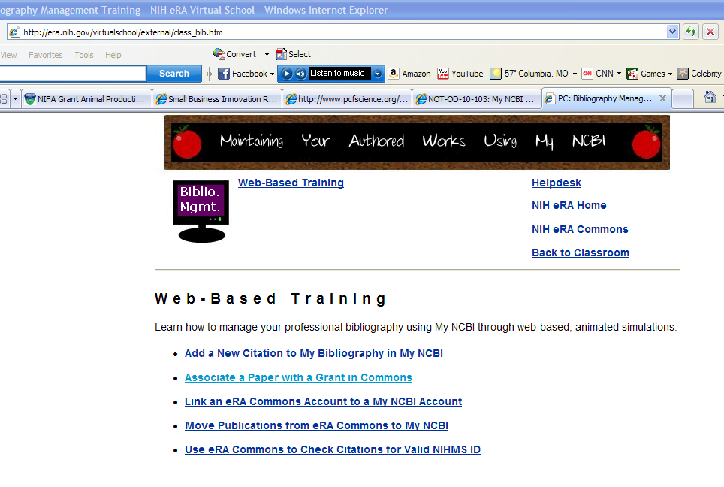
Progress Reports Associating a paper with a grant in eSnap http://era.nih.gov/virtualschool/external/class_bib.htm

Slide 27
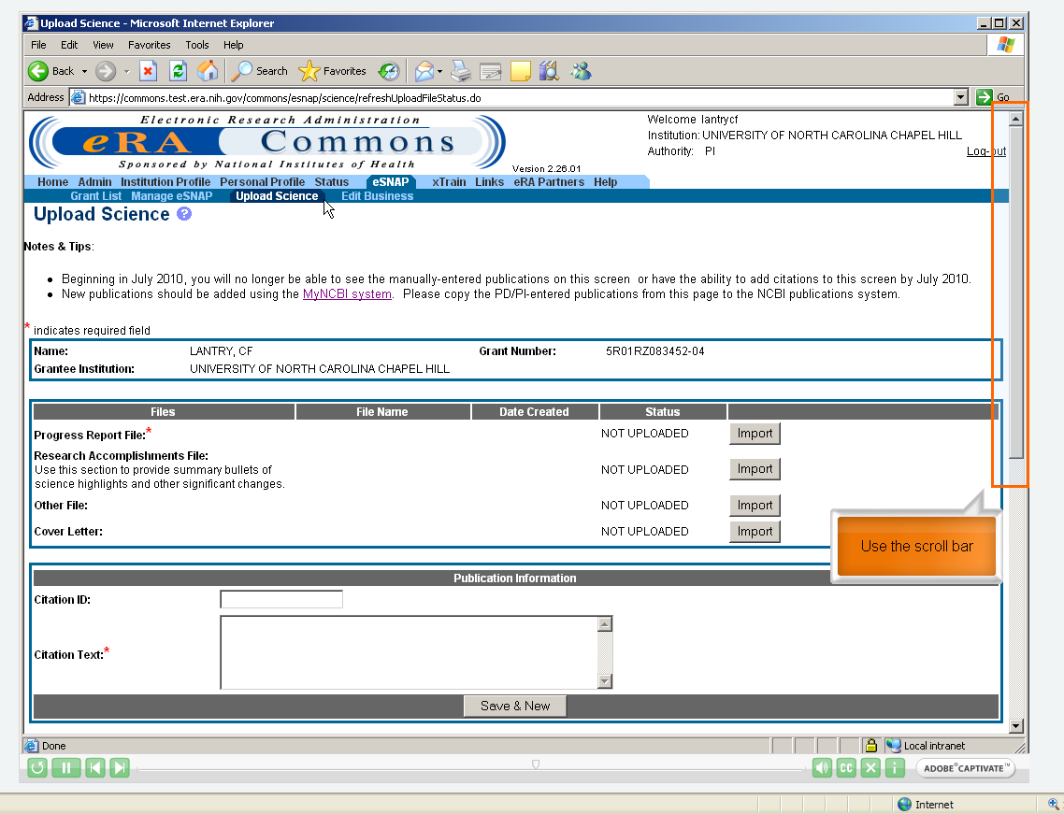

Slide 28
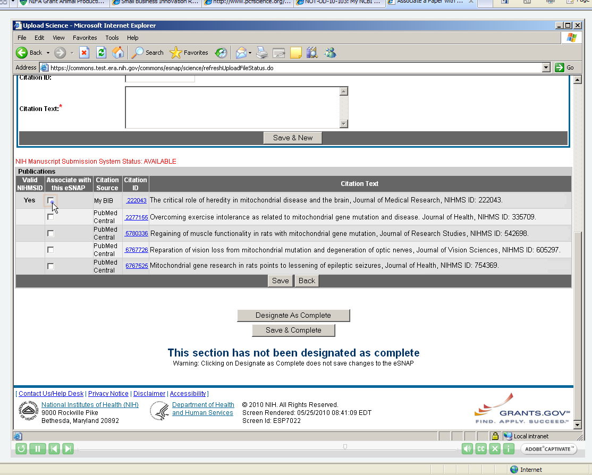

Slide 29
