Slide 1
Appropriate Drug Prescribing in Older Adults
The same medicine will both harm and cure me.
(Res eadem vulnus opemque feret)
OVID, Tristia

Slide 2
Objectives
Understand age-related changes in pharmacokinetics and pharmacodynamics
Recognize high risk medications which should generally be avoided in older adults
Recognize common drug-drug interactions in older adults
Perform a quick drug list review and revision using these principles

Slide 3
The same medicine will both harm and cure me. (Res eadem vulnus opemque feret).
  OVID, Tristia, Book II, L. 20
Good medicine is man’s salvation. Excessive use gives aggravation.
  Romanoff, Alexis Lawrence; Encylopedia of Thoughts, Couplets
Formerly, when religion was strong and science weak, men mistook magic for medicine; now, when science is strong and religion weak, men mistake medicine for magic.
  Szasz, Thomas; The Second Sin, Science and Scientism (p. 115)
The desire to take medicine is perhaps the greatest feature which distinguishes man from animal.
  Osler, Sir William; In Harvey Cushing, The Life of Sir William Osler, Volume I (p. 342)
Frequent changes of medicines proclaims the ignorance of the physician and is calamitous for the patients.
  Hoffman, Friedrich; Fundamenta Medicianae, Therapeutics, Chapter I, 37 (p. 137)

Slide 4
Case Presentation
Patient S.L. is a 68 year old female with lifelong mental illness including institutional care. She is brought for evaluation of possible dementia. Current symptoms include fluctuating mental status, gait disorder, falls, urinary incontinence, daytime hypersomnolence and nocturnal sleep disturbances.
PMH includes DM type 2, HTN, Dyslipidemia, (?) Schizophrenia, Urinary Incontinence, Unspecified GI disorders (?gastroparesis)
Slept through parts of the interview. Exam notable for pedal edema, unsteady gait, parkinsonism
Notes:
Sometimes an example is more helpful than anything else, particularly one to the extreme.
This is a real case….

Slide 5
Case Presentation: Medications
Prevacid
Lantus Insulin
Sliding Scale Insulin QID
Metformin (BID)
Allegra
Aspirin
Lasix (BID)
Potassium chloride
Lisinopril
Synthroid
Fosamax
Advair (BID)
Effexor (not XR –takes BID)
Lipitor
Metoprolol
Nexium
Actos
Reglan (QID)
Ambien
Alprazolam (up to QID)
Cozaar
HCTZ
Abilify
Metamucil
Skelaxin
Colace
Albuterol
Risperdal
Notes:
28 prescriptions, totalling close to 40 medication administrations daily.
How could this possibly be done correctly?

Slide 6
Case Presentation
Patient returns in 8 weeks
Improved mental status and sleep
No longer incontinent
Improved gait
Improved mood
Daughter states “the best health my mother has been in during her entire life”
Notes:
Definitely one success story, and one of the most satisfying. Patient comes back frequently and has referred on many other patients.

Slide 7
Background
What is the role of the internist or PCP?
What do our patients want from us?
How is geriatrics different from internal medicine?
Are all geriatric patients the same?
“Polypharmacy” is a common reason for patient dissatisfaction and for seeking geriatrics consultation
Notes:
Geriatrics focuses more on function rather than diseases.

Slide 8
Background
Medicine has largely become the practice of drug prescribing
Signs and symptoms reflexively trigger a change in pharmacologic management
Increasing emphasis on preventing iatrogenic injuries and improving safety
Increasing emphasis on implementing various guidelines for diseases
Non-pharmacologic interventions are often available but difficult to implement
Notes:
Physicians have largely become drug dealers
Concerns about being flagged for a deficiency for not using medications (QI measures)
Time is on overriding problem

Slide 9
Target Population for This Discussion
The oldest old (over 75-80)
All patients with impaired cognition
Patients taking psychoactive medications
Patients with depression
Patients with history of falls, abnormal gait, or hip fracture
Patients with weight loss
Patients with incontinence and constipation
Nursing home residents

Slide 10
Categories of Drug Related Problems
Polypharmacy
Adverse drug reactions (ADR’s)
Subtherapeutic drug dosage
Overdose
Failure to receive a prescribed drug
Adverse effect of drug withdrawal
Drug use without an indication
Duplication of drug therapy
Drug-Drug interaction
Underuse of beneficial therapies
Notes:
Polypharmacy is often used as the term for undesirable drug prescribing practices in the elderly, but this is only one aspect of the problem.

Slide 11
Polypharmacy
No absolute definition
Not necessarily inappropriate
Medications can accumulate over decades
Every old and new medication taken should be questioned
Avoid using medications to treat adverse effects of other medications
Notes:
3-5 meds often used as cutoff (ha-ha)

Slide 12
Adverse Drug Reactions: Risk Factors
Increasing age
Increasing number of prescriptions
Female
Lower body weight,
Hepatic or renal insufficiency
History of prior drug reactions

Slide 13
Altered Drug Metabolism and Effects with Aging
Pharmacokinetics – How the body handles a particular drug
  Absorption
  Distribution
  Metabolism
  Elimination
Pharmacodynamics – How the target responds to the drug
Drug-Drug Interactions
Drug-Disease Interactions
Diminished organ reserve

Slide 14
Pharmacokinetics & Aging
Absorption:
  Minimal effects from aging
Distribution (volume of distribution – Vd):
  Decreased LBW and body water with age
  Decreases Vd of drugs distributed to muscle or water (aminoglycosides, ethanol, some antibiotics and anti-arrhythmics), resulting in higher peak levels
  Increases Vd (reservoir) of drugs distributed to adipose (amiodarone, diazepam, haloperidol)
  Particularly important for “loading” doses
Protein Binding: Often decreased in older patients
  Can result in higher free levels, particulary if displaced by another protein bound drug (warfarin and aspirin)
  Measured total serum level may be low but free level is still therapeutic
  Probably affected more by drug interactions or disease than age per se
Notes:
Displacement of 1-2% of bound warfarin double or triples the anticoagulant activity

Slide 15
Specific Concerns in LTC
Institutionalized elderly use more medications than any other group
Average resident takes 7 different medications daily
2/3 of patients will have an ADR
Patients have multiple illnesses
  High rates of cardiovascular disease and dementia
Notes:
Double the medications use of community dwelling elderly
Number of pills typically exceeds number of medications

Slide 16
Case Discussion
Scenario – You are the physician for a skilled nursing facility and have accepted a patient who is transferred from the hospital for rehabilitation following a hip fracture. The following discharge summary and medication orders are sent in transfer. You are responsible for signing off on the orders, and decide to review her medications and make any changes you feel are appropriate.
Discharge Summary: The patient is a 78 year old female with a past medical history significant for Class III CHF, atrial fibrillation, urinary incontinence, CAD, and GERD - admitted 8 days ago with a right hip fracture. Her hospital course was complicated by a urinary tract infection and acute agitated delirium. Most recent labs prior to discharge notable for Hgb 9.8, MCV 88, INR 2.9, Cr 1.4.
Medication orders:
1. Captopril 50mg po TID
2. Warfarin 8mg po daily
3. Iron sulfate 325mg po TID
4. Aspirin 81mg po daily
5. Darvocet N-100 1-2 po q4-6H PRN pain
6. Metocloperamide 10mg po qAC and qHS
7. Oxybutnin 5mg po TID
8. Ciprofloxacin 500mg po BID
9. Fluoxetine 20mg po daily
10. Furosemide 20mg po BID
11. Tylenol 1000mg po QID PRN
12. Ultram 50mg po TID
13. Digoxin 0.25mg po daily
14. Amitryptiline 50mg po qHS for insomnia
15. Haloperidol 5mg IV q4H PRN
16. Phenergan 25mg po/pr q6H PRN
NKDA
On your exam: vitals normal with a regular pulse. Patient is confused and agitated, has difficulty cooperating with the examination. The lungs are clear bilaterally. There is fullness and tenderness in the suprapubic region with hypoactive bowel sounds. You note rest tremor in both upper extremities with some rigidity. There are stage 1 pressure changes in the sacral region (nonblanching erythema).
Your task: Identify the potential problems with this medication regimen. Potential problems include dosing errors, adverse drug effects, contraindicated medications, ineffective medications, and absence of potentially beneficial medications.

Slide 17
MEDICATION LIST
1. Captopril 50mg po TID
2. Warfarin 8mg po daily
3. Iron sulfate 325mg po TID
4. Aspirin 81mg po daily
5. Darvocet N-100 1-2 po q4-6H PRN pain
6. Metocloperamide 10mg po qAC and qHS
7. Oxybutnin 5mg po TID
8. Ciprofloxacin 500mg po BID
9. Fluoxetine 20mg po daily
10. Furosemide 20mg po BID
11. Tylenol 1000mg po QID PRN
12. Ultram 50mg po TID
13. Digoxin 0.25mg po daily
14. Amitryptiline 50mg po qHS for insomnia
15. Haloperidol 5mg IV q4H PRN
16. Phenergan 25mg po/pr q6H PRN

Slide 18
Strategies to Improve Compliance
Make drug regimens and instructions simple
Use the same dosage schedule whenever possible
Time the dose in conjugation with a daily routine
Instruct relatives and caregivers on the drug regimen
Enlist others (home health, pharmacist) for compliance
Make sure the elderly patient can get to a pharmacist, can afford prescriptions, and can open the container
Use aids (pillboxes, calendars) /supervision
Keep updated medication records
Review knowledge, compliance, drug regimens
Inform the patient about potential adverse reactions from a med and what actions should they occur

Slide 19
Iron in Older Adults
Oral iron causes frequent gastrointestinal side effects.
Absorption of iron increases in patients with true iron deficiency.
One study showing that low dose oral iron (15mg elemental Fe) was as effective as high dose iron (150mg), with fewer adverse effects.
  Abdominal discomfort 70% vs. 20%
  Nausea and vomiting 67% vs. 13%
  Constipation 23% vs. 0%
  Diarrhea 70% vs. 13%
Iron best absorbed in acidic environment without food
  Absorption may be poor on PPI or H2RA
  Can consider giving with ascorbic acid
Start with lowest dose and follow response, titrate if needed
  Ferrous fumarate — 106 mg elemental iron/tablet
  Ferrous sulfate — 65 mg elemental iron/tablet
  Ferrous gluconate — 28 to 36 mg iron/tablet
Iron can effect absorption of other drugs.
  Quinolones, levothyroxine, tetracyclines, levodopa most notable
Ensure that the diagnosis is correct (AOCD?)
TID iron is on the Beers list and on the banned list for nursing home use.
Consider parenteral iron if side effects intolerable
Reference: Rimon E, Kagansky N, Kagansky M, et al. “Are we giving too much iron? Low-dose iron therapy is effective in octogenarians.” American Journal of Medicine 2005;118:1142-1147.
Return to Medication List

Slide 20
Aspirin and Warfarin
There are very few indications where the combination of aspirin and warfarin has been shown to be superior to warfarin alone
  High risk mechanical heart valves
  Antiphospholipid antibody syndrome
The most common reason this is done is probably CAD with AF
  2.5 million in North America with AF, up to 40% have AF
  Not shown to decrease the rate of stroke but doubles the risk of major bleeding
ASA displaces warfarin from albumin
Reference: Dentail, F, Douketis J, Lim W, Crowther M. “Combined Aspirin-Oral Anticoagulant Therapy Compared with Oral Anticoagulant Therapy Alone Among Patients at Risk for Cardiovascular Disease: A Meta-analysis of Randomized Trials.” Arch Intern Med. 2007;167:117-124.
Return to Medication List

Slide 21
Digoxin
Digoxin excess: arrhythmia (MAT, VT), weakness, nausea, vomiting,
Changes in body composition with age
  Does digoxin distribute to muscle or fat?
  Decreased Vd with age
Changes in renal function with age
Return to Medication List

Slide 22
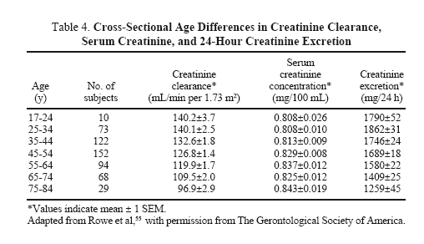
Changes in Renal Function with Age
Return to Medication List

Slide 23

Anticholinergic Medications
Some of the original “herbal medications”
Examples
  Sedating Antihistamines (Benadryl, Chlor-trimitron, others)
  Tricyclic Antidepressants (Elavil, Doxepin)
  Typical Antipsychotics (Haldol, Risperdal, Thorazine)
  Antispasmodics (Bentyl, Levsin, Donnatol)
  Urinary Agents (Ditropan, Detrol)
  Antiemetics (Tigan, Phenergan, Compazine, Scopalamine)
Hyoscyamus niger

Slide 24
Anticholinergic Medications
Adverse Effects
  Urinary Retention
  Orthostatic Hypotension
  Confusion, Somnolence, Delirium, Hallucinations
  Dry Mouth (Xerostomia)
  Constipation
  Falls
  Antagonize the effects of cholinesterase inhibitors
Notes:
Any one of these side effects may result in increased nursing efforts, higher costs, fractures due to falls, and new prescriptions to treat the side effects.

Slide 25
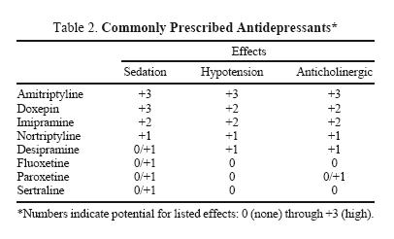
Anticholinergic Antidepressants
Chutka DS, Takahashi PY, Hoel RW. “Inappropriate Medications for Elderly Patients.” Mayo Clin Proc. 2004; 79:122-139.
Anticholinergics Slide; More on TCA’s

Slide 26
Tricyclic Antidepressants in Older Adults
Elderly are prone to toxicity and adverse effects
May have prominent anticholinergic effects
  Dry mouth
  Confusion
  Orthostatic hypotension
  Constipation
  Mydriasis
TCA’s should not be used for the treatment of depression in the elderly
Smaller doses for chronic pain or insomnia may be tolerated well by some older patients

Slide 27
Antipsychotic (Neuroleptics)
Examples
  Traditional/Typical Antipsychotics
    Mellaril, Thorazine, Prolixin, Haldol
  Atypical Antipsychotics
    Risperidone (Risperdal), Olanzapine (Zyprexa), Quetiapine (Seroquel), Geodon, Abilify
  Antiemetics
    Compazine, Tigan, Phenergan, Reglan***
Adverse Effects
  Anticholinergic Effects
  Metabolic – Hyperglycemia, Dyslipidemia
  Arrhythmia
  Thrombotic events (stroke, DVT)
  Drug-Induced Movement Disorders
    Parkinsonism
    Tardive Dyskinesia, Tardive Akathisia
Notes:
The use of these medications in LTC largely led to the regulatory changes adopted by CMS.

Slide 28
Drug Induced Parkinsonism
Indistinguishable from Parkinson’s Disease
  Tremor, Slowed movements, Rigidity, Shuffling gait, Falls, Postural instability
Elderly most susceptible
Can occur after a single dose in some individuals
Risk increases with continued use
Highest risk with older antipsychotics, antiemetics, and metocloperamide (Reglan)
Lowest risk with quetiapine (Seroquel) and clozaril (Clozapine)*
Usually resolves with drug withdrawal

Slide 29
Tardive Dyskinesia
Abnormal involuntary movements
  Repetitive, somewhat rhythmic
  Often involves the tongue, jaw, cheeks and lips, trunk, extremities
Elderly most susceptible (30% at one year and 60% at three years)
Women at higher risk
Spontaneously resolves in some patients
Higher risk with older antipsychotics
May get worse when medications are stopped
Notes:
Can manifest as tongue thrusting, lip smacking, lip pursing, grimacing, chewing, rocking, hmming, grunting,

Slide 30
Preventing misuse of psych drugs
D: Describe
Clarify symptoms
R: Reason for the behavior
Psychiatric symptoms are often caused by medical conditions or psychosocial issues
N: Non-medication Approaches
Consider behavioral modifications, environmental manipulations
O: Order Medication

Slide 31
Narcotics and Pain Management
The double-edged sword
  Increasing pressure to recognize and treat pain (the fifth vital sign)
  Recognition of potential adverse effects
  NSAIDs often not safe, including COX-2 inhibitors
Inappropriate Agents in this class
  Meperedine (Demerol) – normeperidine accumulation and seizures, myoclonus, SS
  Pentazocine (Talwin)
  Propoxyphene (Darvocet) – ineffective analgeisic with class adverse effects
Potentially problematic due to varied CYP450 metabolism
  Codeine
  Tramadol (Ultram)
Known Class Adverse Effects
  Constipation
  Somnolence, Confusion, Falls
  Pruritis
  Nausea
  Dependence and Tolerance

Slide 32
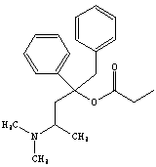
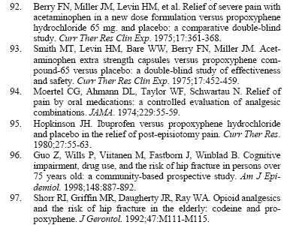
Propoxyphene (Darvocet)
Longstanding member of the Beer’s inappropriate drug list for elderly patients
12th highest-selling generic drug in 2004
  23 million prescriptions filled and sales that year of $291 million
Analgesic properties are inferior to other opiates
  May not be better than NSAID’s or acetaminophen alone for acute pain
  Still has some opiate side effects
The elimination half-lives of both propoxyphene and its even more potent metabolite, norpropoxyphene, are prolonged in healthy elderly subjects relative to young controls
  In young people, propoxyphene had a 13.2 day half-life
  23.7 day half-life in the elderly group
Recent call from Public Citizen to phase out distribution in the U.S.
Narcotics and Pain Management

Slide 33
Warfarin – Drug Interactions
Doublecheck before starting any new medication with warfarin
Important cytochrome P-450 interactions
Drug highly bound to albumin, which can be displaced by other protein-bound medications (Aspirin, others)
Risk of adverse outcome from drug interaction is significant (both from bleeding and breakthrough thrombotic events)
Most Common/Important interactions
  Other anticoagulants, antiplatelet agents
  Steroids
  Antibiotics, Antibiotics, Antibiotics- Can often reduce the dose of warfarin empirically and follow the INR closely
Dosing help: www.warfarindosing.org

Slide 34
Fluoxetine (Prozac) in Older Adults
Use of fluoxetine should be avoided in the elderly
Prolonged half-life can be even longer with advancing age
  Cases of Serotonin Syndrome reported with a new SSRI started within 5 weeks of discontinuation of fluoxetine
High rate of anorexia in the elderly
Multiple CYP450 drug interactions

Slide 35
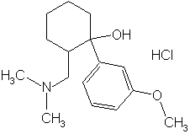
Tramadol (Ultram) in the Elderly
Atypical opiate analgesic
Partial mu receptor agonist
Central re-uptake inhibitor of serotonin and norepinephrine
At high doses, can induce serotonin release
Numerous case reports of Serotonin Syndrome in patients taking tramadol in combination with SSRI’s, TCA’s, venlaflaxine, atypical antipsychotics, and tramadol alone
Doses >300mg/day reported to cause seizures
Metabolized by CYP2D6, which is inhibited by some SSRI’s

Slide 36
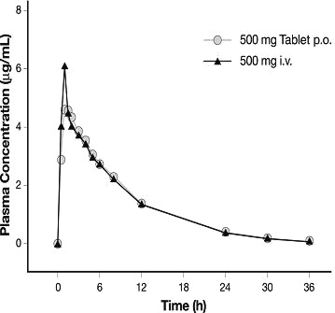
Quinolones in the Older Adult
Commonly used antibiotic class in this population
Frequently require renal dosing adjustment
Complex with divalent and trivalent cation salts when co-administered orally, markedly reducing bioavailability
  Iron
  Zinc
  Calcium
  Magnesium/Aluminum (antacids)
Adverse effects
  Tendinopathy more common in elderly
    Achilles' tendon most often affected (rupture)
    More common with concomitant corticosteroids
    More common in transplant patients
    10-15% of patients develop arthritic symptoms while taking them
  Delirium
  Hypo- and hyperglycemia
  QT prolongation (check www.qtdrugs.org)

Slide 37
CYP2D6
CYP2D6 shows the largest phenotypical variability amongst the CYPs, largely due to genetic polymorphism.
The CYP2D6 function in any individual patient may be described as one of the following:
  extensive metaboliser - these subjects have normal or reduced CYP2D6 function
  poor metaboliser - these subjects have no CYP2D6 function
  ultrarapid metaboliser - these subjects have multiple copies of the CYP2D6 gene expressed, and therefore greater-than-normal CYP2D6 function
6-10% of Caucasians may be 2D6 poor metabolisers
Amplichip - automated determination of a patient's CYP2D6 (or CYP2C19) genotype.
  Genotype assays do not give information on the phenotype and therefore cannot identify ultrarapid metabolisers.
Notes:
The genotype accounts for normal, reduced and non-existent CYP2D6 function in subjects.

Slide 38
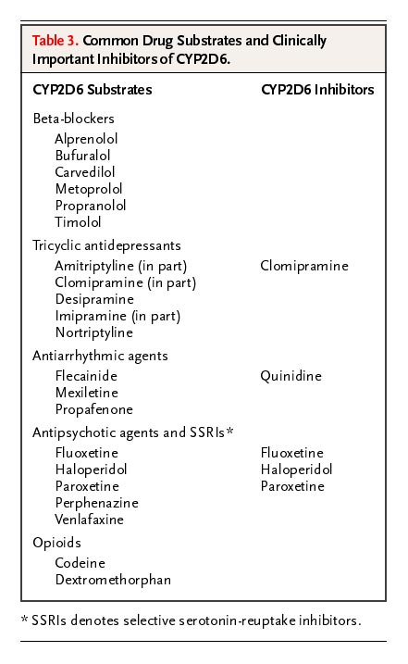

http://www.drug-interactions.com
Common Drug Substrates and Clinically Important Inhibitors of CYP2D6
Wilkinson, G. R. N Engl J Med 2005;352:2211-2221
Notes:
Table 3. Common Drug Substrates and Clinically Important Inhibitors of CYP2D6.

Slide 39
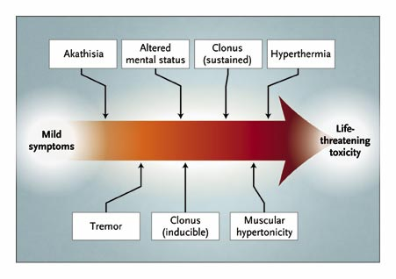
Serotonin Syndrome – A Spectrum of Toxicity
Spectrum of Clinical Findings
Boyer, E. W. et al. N Engl J Med 2005;352:1112-1120
Notes:
Figure 1. Spectrum of Clinical Findings. Manifestations of the serotonin syndrome range from mild to life-threatening. The vertical arrows suggest the approximate point at which clinical findings initially appear in the spectrum of the disease, but all findings may not be consistently present in a single patient with the serotonin syndrome. Severe signs may mask other clinical findings. For example, muscular hypertonicity can overwhelm tremor and hyperreflexia.

Slide 40
 | Mild serotonin excess* | Moderate (SS) | Severe Serotonin toxicity
Cognitive/ Behavioral | Restlessness | Elevated mood Akathisia Impaired consciousness Mild agitation Pressured speech | Coma Generalized tonic-clonic seizures Agitated delirium
Autonomic instability | Diaphoresis Shivering | Fever up to 40C Diaphoresis Shivering Sweating Tachycardia Dilated pupils Hyperactive bowel sounds | Fever may be over 41C Hypotension Shock
Neuromuscular | Tremor Myoclonus | Tremor Myoclonus Hyperreflexia Rigidity More notable in LE’s Horizontal ocular clonus Neck posturing and turning | Rhabdomyolysis Severe rigidity Sustained clonus
Misc | *single symptom may predominate |  | DIC Renal failure Transaminitis Metabolic acidosis

Slide 41
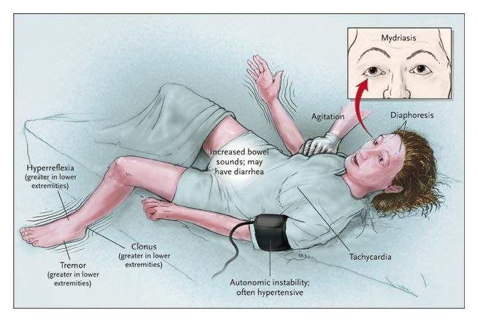
Findings in a Patient with Moderately Severe Serotonin Syndrome
Boyer, E. W. et al. N Engl J Med 2005;352:1112-1120
Notes:
Figure 2. Findings in a Patient with Moderately Severe Serotonin Syndrome. Hyperkinetic neuromuscular findings of tremor or clonus and hyperreflexia should lead the clinician to consider the diagnosis of the serotonin syndrome.

Slide 42
Excess Tylenol
Maximum dose of 4000mg daily
Often stop at 1000mg TID (3g daily)
  Some patients will develop mild, asymptomatic transaminitis even with this dose
Inadvertent toxicity with therapeutic intent often related to Tylenol-containing opiate analgesics alone or in combination
Watch for patients with regular alcohol use
Can interact with warfarin and increase INR

Slide 43
Practical Tips for Appropriate Drug Prescribing in Older Adults
Start low, go slow…but get there
Use the lowest effective dose
Avoid drugs with prolonged half-lives
Keep a list of all current prescription and over-the-counter or herbal medications
List the indication for each drug in the chart
Explain common adverse effects in advance and what to do
Don’t be the first doctor to use a new drug, or the last…

Slide 44
Caveats
Not all older adults are the same
‘Frailty’ may be a better indicator than age
  Frailty = dementia, falls, incontinence, weight loss, dependence for ADL’s
Goals for geriatric, frail patients are different
  Focus on functional performance, quality of life, patient’s wishes
  “The desire to live is the best medicine of all.”
    Romanoff, Alexis Lawrence; Encyclopedia of Thoughts; Aphorisms 2048
Individualized, patient-centered care is the cornerstone of geriatrics

Slide 45
Dr. Moylan’s Drug Paradise
A master drug list
A central pharmacy
New drugs
  Once daily, once monthly
  No active metabolites
  No drug interactions
  Combination products
  Minimal titrations
Notes:
There is no Master List now, only the perception of one. EMR have not helped so far (VA may be the exception)
One list for the physician, pharmacy, patient, subspecialist,
Any medication changes make it to each involvest person
Central pharmacy for coordination of prescribing, drug interactions, cost considerations

Slide 46
References & Recommended Reading
Avorn J & Gurwitz JH. “Drug Use in the Nursing Home.” Ann Intern Med. 1995; 123:195-204.
Beers MH. “Explicit Criteria for Determining Potentially Inappropriate Medication Use by the Elderly.” Arch Intern Med 1997; 157:1531-1536.
Bressler R & Bahl JJ, “Principles of Drug Therapy for the Elderly Patient.” Mayo Clin Proc. 2003;78:1564-1577.
Bootman JL, Harrison DL, Cox E. “The Health Care Cost of Drug-related Morbidity and Mortality in Nursing Home Facilities.” Arch Intern Med. 1997; 157:2089-2096.
Chutka DS, Takahashi PY, Hoel RW. “Inappropriate Medications for Elderly Patients.” Mayo Clin Proc. 2004; 79:122-139.
Cooper JW. “Probable Adverse Drug Readctions in a Rural Nursing Home Population: A Four-year Study.” JAGS. 1996; 44:194-197.
Cooper JW. “Adverse Drug Reaction-related Hospitalizations of Nursing Facility Patients: A 4-year Study.” South Med J. 1999; 92:485-490.
Fick DM, Cooper JW, Wade WE. “Updating the Beers Criteria for Potentially Inappropriate Medication Use in Older Adults.” Arch Intern Med. 2003; 163:2716-2724.
Hanlon JT, Schmader KE, Kornkowski MJ, et al. “Adverse Drug Events in High Risk Older Outpatients.” JAGS. 1997; 45: 945-948.

Slide 47
References – Serotonin Syndrome
Bair MJ, Robinson RL, Katon W, et al. “Depression and pain comorbidity. A literature review.” Arch Intern Med 2003;63:2433-2445.
Birmes P, Coppin D, Schmitt L, Lauque D. “Serotonin syndrome:a brief review.” CMAJ 2003;168:1439-1442.
Boyer EW, Shannon M. “The Serotonin Syndrome.”. 2005;352:1112-112o. N Engl J Med
Gnanadesigan N, Espinoza RT, Smith R, et. al. “Interaction of serotonergic antidepressants and opioid analgesics: is serotonin syndrome going undetected?” J Am Med Dir Assoc 2005;6:265-269.
Gillman PK. “The spectrum concept of serotonin toxicity (letter).” Pain Med 2004;5:231-232.
Kitson R, Carr B. “Tramadol and severe serotonin syndrome (letter).” Anaesthesia 2005;60:934-935.
Mahlberg R, Kunz D, Sasse J, Kirchheiner J. “Serotonin syndrome with tramadol and citalopram (letter).” Am J Psychiatry 2004;161:1129.
Smith MT, Levin HM, Bare WW, et al. “Acetaminophen extra strength capsules versus propoxyphene compound-65 versus placebo: a double-blind study of effectiveness and safety.” Curr Ther Res Clin Exp. 1975;17:452-459.

